Slide 1
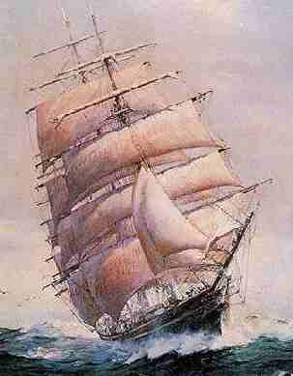
The Search for Spices

Slide 2
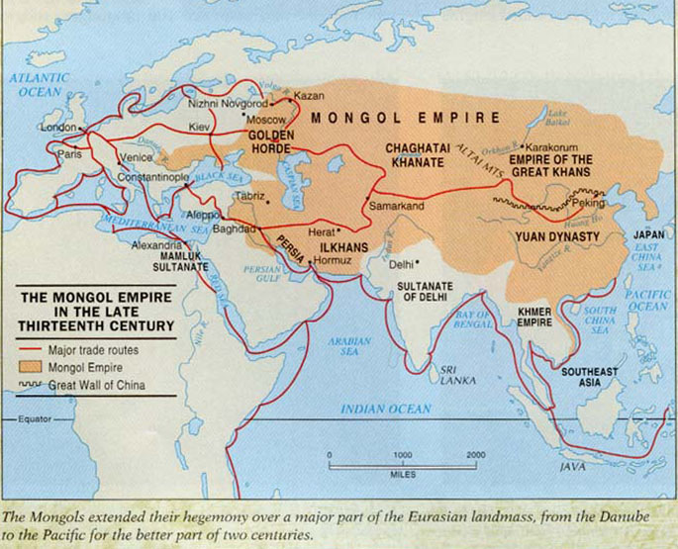
Early Trade
The Black Death disrupted trade
Without advanced technology, long-distance trade was lengthy and expensive

Slide 3
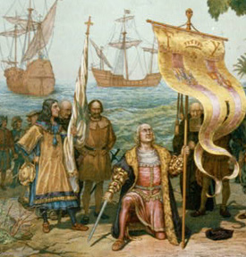
Why did Europeans want to explore the oceans?
Desire for wealth
Bypass the Mediterranean and the Muslim and Italian merchants who controlled trade there
Find new trade routes
The Renaissance spirit of adventure

Slide 4
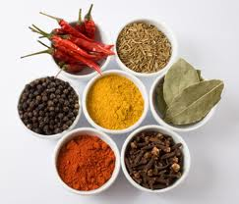
Spices
What resources were explorers looking for? SPICES!!
After the Black Death, the population of Europe grew and so did their demand for trade goods.
The most valued trade items were spices, like cinnamon, cloves, nutmeg, and pepper.
They were used to:
To preserve food
To add flavor to dried and salted meat
To make medicines and perfumes

Slide 5
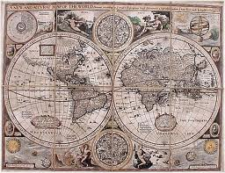
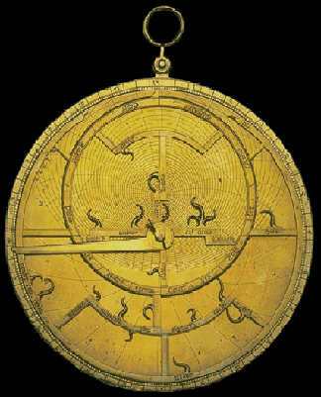
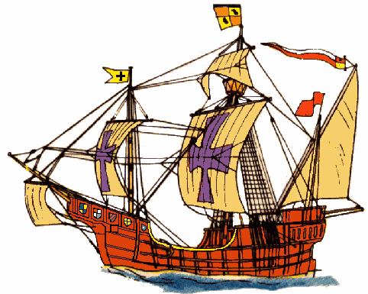
Improved technology
Cartographers (mapmakers) created more accurate maps and sea charts
Sailors used astrolabes (instruments to determine latitude at sea)
They also developed the caravel, a ship with both square and triangular sails that made it easier to sail across or into the wind.

Slide 6
Early Explorers

Slide 7
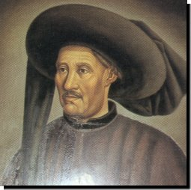
Prince Henry the Navigator
1430s
Gathered experts to revolutionize exploration. Sent ships to explore the west coast of Africa.
Allowed Portugal to dominate exploration.

Slide 8
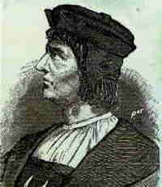
Bartholomeu Dias
1488
Rounded the bottom of Africa.
Opened sea route to Asia.

Slide 9
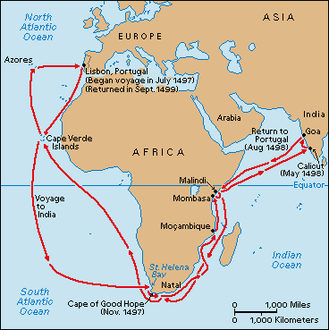
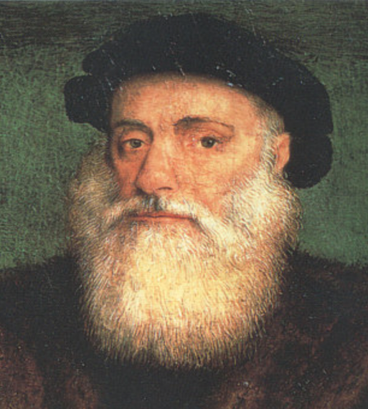
Vasco da Gama
1497-1498
The first European to reach
India through an overseas route.
Portuguese seized key ports in Indian Ocean for trading empire

Slide 10
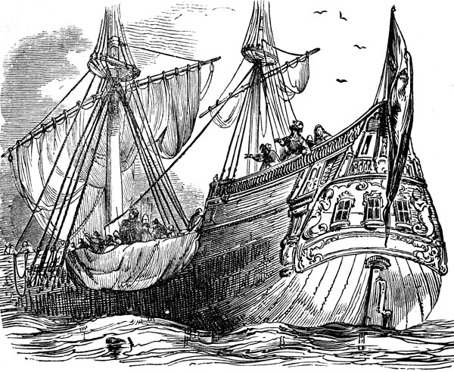
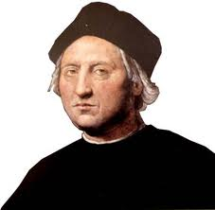
Christopher Columbus
1492
Reached the Caribbean, convinced he reached India.
New World opened for trade, colonies, and settlement.

Slide 11
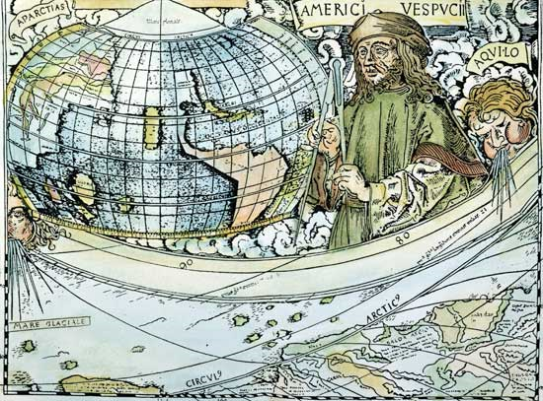
Amerigo Vespucci
1497-1504
Italian sailor, sailed to the New World.
He called the lands a “New World”. A German mapmaker read his reports and named the land “America” after him.

Slide 12
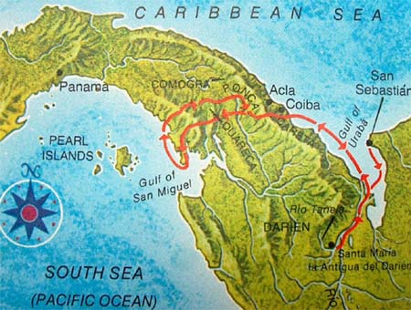
Vasco Nunez de Balboa
1513
Discovered the “South Sea” on the other side of Panama.
Established the fact that North America was not part of Asia.

Slide 13
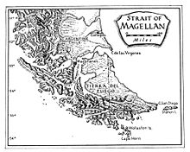
Ferdinand Magellan
1519-1521
Went around South America, reached the Philippines.
Spanish first to circumnavigate the globe

Slide 14
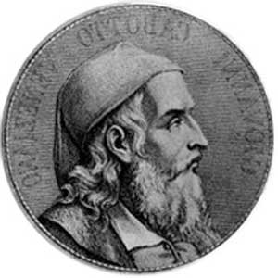
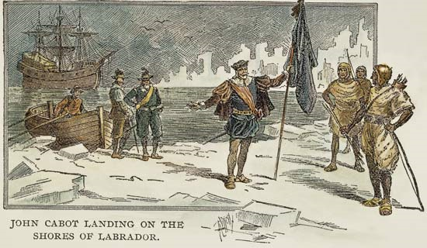
John Cabot
1497
A more northern route than Columbus had found.
Rich fishing grounds off of Newfoundland, which he claimed for England

