Slide 1
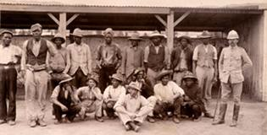
Turbulent Centuries in Africa

Slide 2
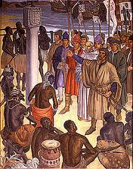
Europeans in Africa
In the 1400s, Portuguese ships explored the coast of West Africa, looking for a sea route to India.
  They lacked the power to push into the African interior, so they set up posts on the coast.
  Other Europeans followed the Portuguese into Africa
    The Dutch, the English, and the French established forts along the western coasts of Africa
      They exchanged muskets, tools, and cloth for gold, ivory hides and slaves

Slide 3
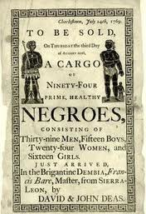
Atlantic Slave Trade
In the 1500s, Europeans began to view slaves as the most important item of African trade
  Slavery had existed in Africa, as elsewhere in the world, since ancient times.
The Atlantic Slave trade began in the 1500s to fill the need for labor in Spain’s American empire.
  Europeans relied on African rulers and traders to seize captives in the interior and bring them to coastal trading posts and fortresses
    There, the captives were exchanged for textiles, metalwork, rum, tobacco, weapons, and gunpowder.

Slide 5
Triangular Trade
Merchant ships brought goods to Africa to be traded for slaves
Products were shipped to Europe or European colonies in the Americas
Middle Passage: Slaves were transported to the West Indies to be exchanged for goods

Slide 6
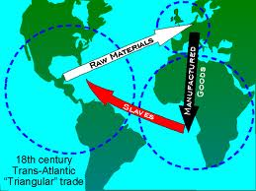
Triangular Trade

Slide 7
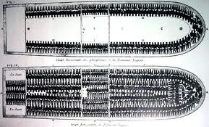
Horrors of the Middle Passage
For enslaved Africans, the Middle Passage was a horror.
Once purchased, Africans were packed below the decks of slave ships.
  Hundreds of men, women, and children were crammed into a single vessel.
  Became known as “floating coffins” on which up to half the Africans on board died from disease or brutal mistreatment.
Some enslaved Africans resisted by trying to seize control of the ships.
Others committed suicide by leaping overboard.

Slide 8
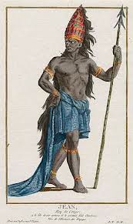
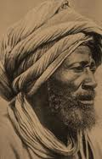
African Leaders
Some African leaders tried to slow down the transatlantic slave trade or even to stop it altogether
An early voice raised against the slave trade was Affonso I, ruler of Kongo in west-central Africa.
  Affonso was alarmed with the way officials would greedily trade in human lives.
    Made appeals to Europe, but his attempt failed
In the late 1700s, another African ruler, The Almamy of Futa Toro tried to halt the slave trade in his lands.
  He forbade anyone to transport slaves through Futa Toro for sale abroad
    The Europeans and African traders simply went around Futa Toro

Slide 9
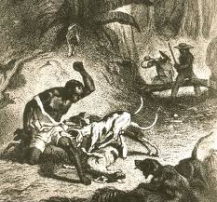
Impact of the Slave Trade
In the year 1780, the slave trade reached a high of 80,000 enslaved Africans reaching the Americas each year.
By the 1800s, when the overseas slave trade was finally stopped, an estimated 11 million enslaved Africans had reached the Americas
  Another 2 million died on the voyage over
The slave trade caused the decline of some African states and the rise of others

Slide 10
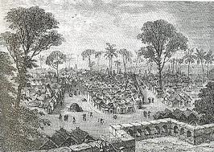
Rise of New African States
In the late 1600s, an able military leader, Osei Tutu won control of the trading city of Kumasi
  From there, he conquered neighboring peoples and organized the Asante kingdom
In the 1700s and 1800s, an Islamic revival spread across West Africa
  Some set up powerful Islamic states

Slide 11
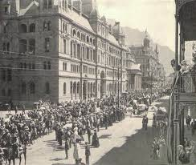
Battle for Power in Southern Africa
Over many centuries, the Bantu-speaking peoples had migrated into southern Africa
In 1652, Dutch immigrants also arrived in the region
  They built Cape Town to supply ships sailing to or from the East Indies
  Dutch farmers, called Boers, settled around Cape Town
    They looked down on the African groups
  In the 1700s, Boer herders and ivory hunters began to push north into Cape Colony were they encountered powerful African groups.

Slide 12
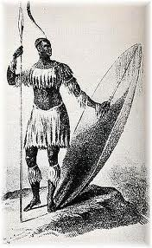
Shaka and the Zulus
The Zulus had migrated into southern Africa in the 1500s
  In the early 1800s, they emerged as a major force under a ruthless and brilliant leader, Shaka
Between 1818 and 1828, Shaka waged war and conquered nearby peoples.
When Shaka’s brother took over the Zulu kingdom, they faced the threat from the Boers migrating north from Cape Colony

Slide 13
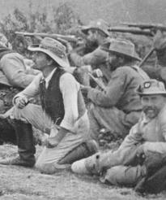
Boers vs. Zulus
In 1815, the Cape Colony passed from the Dutch to the British
  Boers resented British laws that abolished slavery
  To escape British rule, they headed north in the 1830s
As the migrating Boers came into contact with the Zulus, fighting broke out
  Zulu spears couldn’t defeat Boer guns and the struggle for control of the land continued.

Slide 14
Assignment: RAFT Writing
For homework, you will be writing a RAFT
  R- Role (who you are pretending to be)
  A- Audience (who you are writing to)
  F- Format (what style of writing; journal, letter, etc.)
  T- Topic (what you are writing about; slavery)
YOU get to CHOOSE for each of these
Write at least one-paragraph in length, but there is no “length requirement” as long as it is long enough to show you have taken on your role and written to the topic

