Slide 1
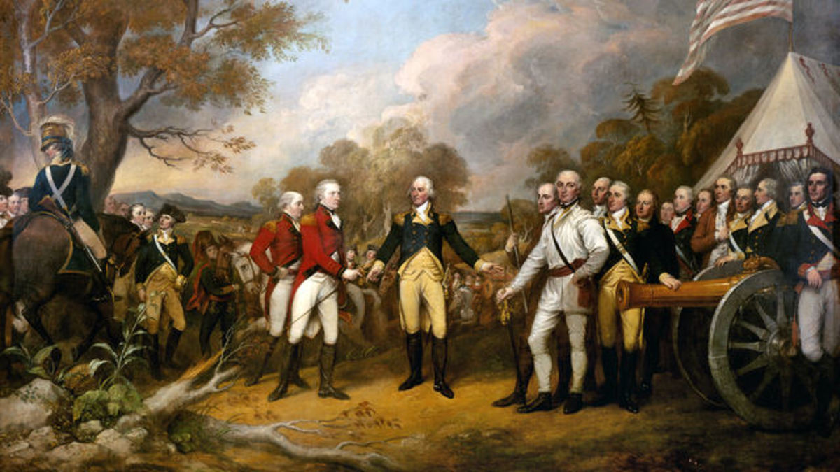
The American Revolution

Slide 2
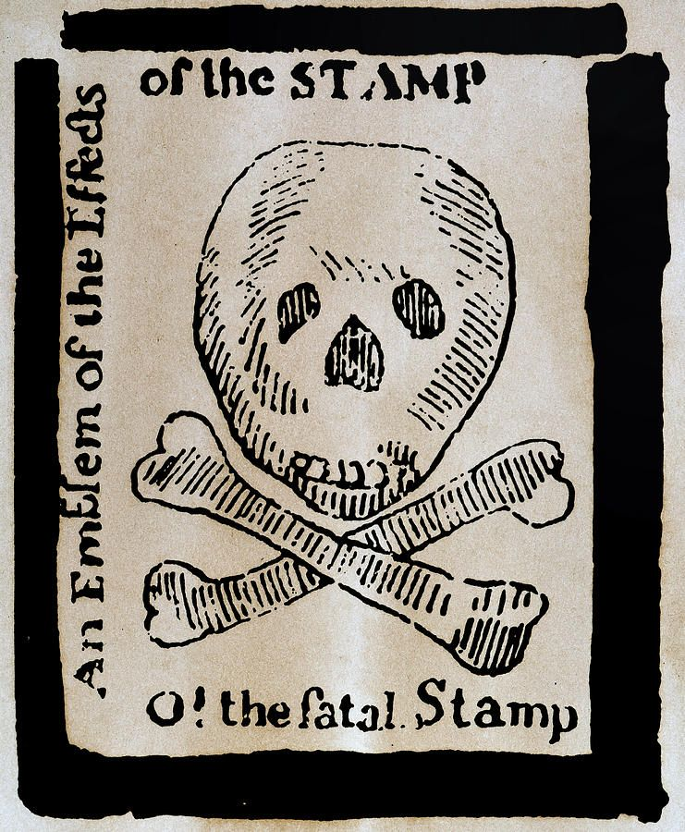
Britain and the American Revolution
The British empire expanded in the 1700s
Caused by growing trade and industry
Expanded by acquiring Canada and India in the Seven Years’ War
The British colonies in North America were controlled by the British Board of Trade, the Royal Council, and Parliament
In actuality, the colonies had legislatures that often acted independently

Slide 3
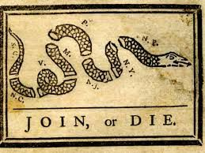
The American Revolution Begins
After the Seven Years’ War, the British needed to raise taxes in the colonies
New colonial taxes from the colonies were needed to cover the high costs of the war
In 1765, Parliament imposed the Stamp Act on the colonies which required certain printed documents to carry a stamp showing that the tax had been paid
Opposition to the tax was widespread and violent until it was repealed in 1766
Further crises came when colonists formed the First Continental Congress to take up arms and organize militias

Slide 4
The American Revolution Begins
Fighting finally erupted in April 1775 at Lexington and Concord, Massachusetts
Meeting after, the Second Continental Congress set up an army led by George Washington
On July 4, 1776, the Second Continental Congress approved the Declaration of Independence written by Thomas Jefferson
With the Declaration, the American Revolution officially began

Slide 5
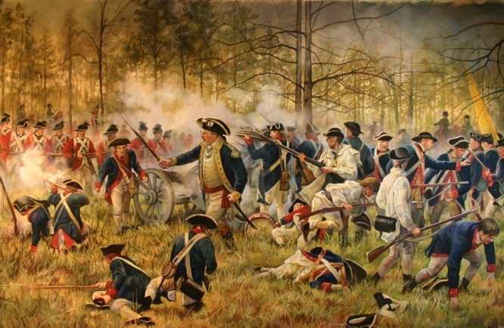
British Defeat
The American colonists got support from foreign countries like France, Spain, and the Dutch Republic
They wanted to see the British defeated
British General Cornwallis was forced to surrender to the American and French forces under Washington at Yorktown in 1781
With this defeat, the British decided to end the war
In 1783, the Treaty of Paris was signed
It granted independence to the American colonies and gave the Americans control of the western territory from the Appalachians to the Mississippi River

Slide 6
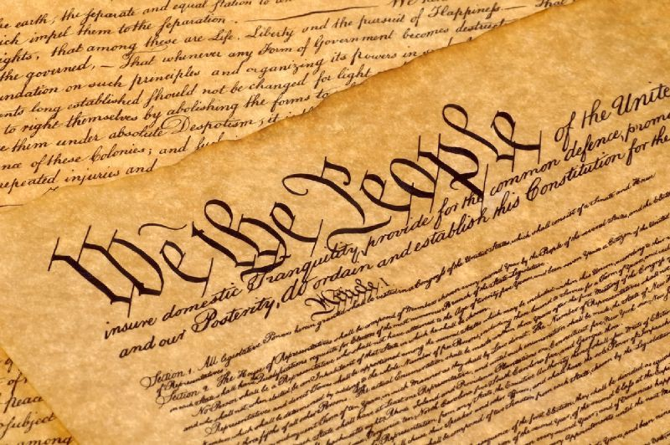
The Constitution
In 1787, delegates met in Philadelphia at the Constitutional Convention to create a new government system
The Constitution proposed a federal system
In this system, the national government and the state governments share power
Also created a three-branch government with judicial, executive, and legislative branches
The purpose was that each branch had power to check, or restrain, acts of the other branches

Slide 7
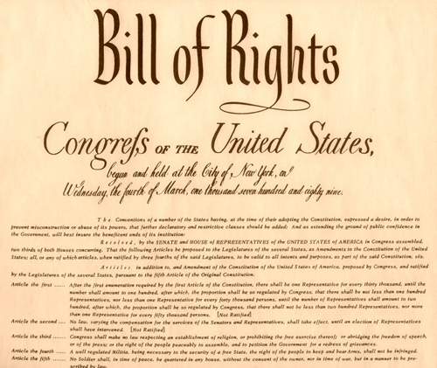
The Bill of Rights
As proposed during negotiations, the new Congress accepted 10 amendments to the Constitution which became the Bill of Rights
The Bill of Rights guaranteed freedom of religion, speech, press, petition, and assembly
Gave Americans the right to bear arms and be protected against unreasonable searches and arrests
Guaranteed trial by jury, due process of law, and the protection of property rights
The documents of the Declaration of Independence, the Constitution and the Bill of Rights were inspired by Enlightenment thinkers like John Locke and the Baron de Montesquieu

