Slide 1
Case Studies from 1945 until Today

Slide 2
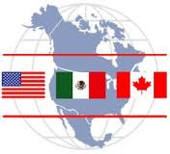
North America

Slide 3
U.S. Foreign Policy
Cold War Policy
  After World War II, the U.S. was a world superpower
  During the Cold War, the main goal of U.S. foreign policy was containing the spread of communism
    Because of this, the U.S. gave economic aid to emerging countries
Policy Today
  After the collapse of the Soviet Union in 1991, the U.S. was the world’s only superpower and peacekeeper
    The U.S. continues to be involved in world affairs today
      The U.S. is mostly concerned with domestic security

Slide 4
U.S. Economy and Government
After World War II, the U.S. economy was not struggling like the rest of Europe
  Many American business have become multinational corporations
  In recent years, the economy of the U.S. has been struggling, leading to an increase in unemployment and a deficit
The government has expanded many social programs like Medicare
Civil rights movement brought about much progress for equality
  There is continuing progress today as civil rights are extended to more groups

Slide 5
Canada
Canada’s population is only 1/10th of the United States
  Most of the population lives within 100 miles of the U.S. border
In recent years, the province of Quebec has wanted autonomy and to become a separate state, favoring separatism
Canada is a member of NATO and many of their troops have served in UN peacekeeping missions around the world
In order to resolve trade disputes, the U.S., Canada, and Mexico set up NAFTA (North American Free Trade Agreement
  NAFTA is responsible for eliminating trade barriers between these nations

Slide 6
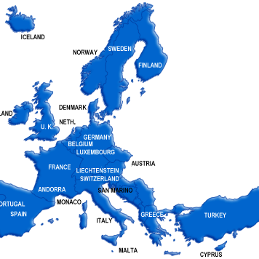
Western Europe

Slide 7
Britain and France
Both countries emerged from WWII weakened and unwilling to hold on to their large empires
After WWII, Britain gave up its colonies but it still had global leadership in the U.N. and NATO
    Today, Britain is still a constitutional monarchy with David Cameron as the current Prime Minister
The “Fifth Republic” was set up in 1958 with war hero Charles de Gaulle as the elected president
  He allowed for many French colonies to achieve independence
    The current President of France is Francois Hollande

Slide 8
Germany
The Cold War left Germany divided between East Germany and West Germany
  West Germany had a booming industrial economy and worked closely with the western democracies
  East and West Berlin were divided by the Berlin Wall, created in 1961
For years the Soviet Union opposed the unification of Germany
  It wasn’t until 1989, with the decline of the Soviet Union, that Germany was able to reunite
    In 1990, German voters approved German reunification with Helmut Kohl as chancellor
  Today, Germany is an industrial power led by chancellor Angela Merkel

Slide 9
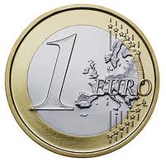
Other Democratic Nations
Many countries in western Europe became welfare states
  These are governments that keep most features of a capitalist economy but takes greater responsibility for the social and economic needs of its citizens
Today, they face growing competition from other parts of the world
  So they became part of the service industry, where they provide services rather than products
In 1957, France, West Germany, Belgium, Italy, the Netherlands, and Luxembourg signed a treaty to form the European Community or Common Market to expand free trade
  In the 1980s and 1990s, the Common Market expanded and took the name European Union
    In 1999, the EU launched the Euro, a single currency to be used by member nations
      Britain did not adopt the Euro

Slide 10
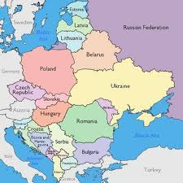
Russia/Eastern Europe

Slide 11
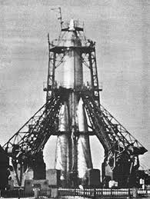
Soviet Government and Economy
The Soviet Union had a large sphere of influence in Eastern Europe and the Balkans
Nikita Khrushchev emerged as the new Soviet leader in 1953
  In 1957, the Soviet Union launched Sputnik
  In 1961, the built the Berlin Wall
  In 1962, Khrushchev tried to build nuclear missile bases in Cuba
    This triggered the Cuban Missile Crisis, which brought the world on the brink of nuclear warfare
Khrushchev’s successor Leonid Brezhnev held power from the mid-1960s until his death in 1982
  In 1979, the Soviets invaded Afghanistan to ensure Soviet influence there
    This drained the Soviet economy and presented a crisis at home
      Goods were inferior to western goods
      Low output was the result of inefficiencies in the bureaucracy

Slide 12
Eastern Europe Under Soviet Control
After WWII, countries in Eastern Europe were ruled by local Communist parties supported by the Soviet Union
  These countries were known as satellites and were members of the Warsaw Pact
Under the Brezhnev Doctrine, the Soviet Union claimed the right to intervene in the affairs of any Eastern European nation

Slide 13
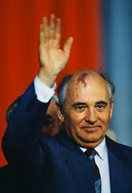
Collapse of Soviet Empire
In 1985, Mikhail Gorbachev came to power in the Soviet Union who wanted to bring about reforms
  At home, Gorbachev launched a two-pronged effort at reform
    1. Glasnost- or openness
    2. Perestroika- the restructuring of the government and economy
Gorbachev’s policies brought economic turmoil
  Shortages grew worse and prices skyrocketed
  Glasnost fed unrest in the Soviet Empire
    The Baltic republics in Estonia, Latvia, and Lithuania, regained independence in 1991
    In Eastern Europe, East Germany, Poland, Romania, and Bulgaria broke away from Soviet control
In 1991, as more Soviet republics declared independence, Gorbachev resigned as President
  The Soviet Union ceased to exist

Slide 14
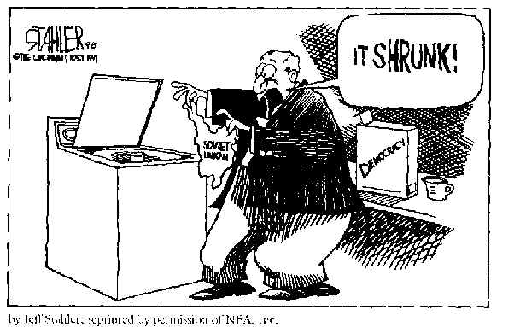

Slide 15
Poland and Yugoslavia
Poland wanted freedom from the Soviets
  In 1980, Lech Walesa organized “Solidarity”, an independent trade union
    When Gorbachev legalized “Solidarity” and in 1989, Poland held their first free elections in 50 years
Yugoslavia was created after WWI as a homeland for South Slavs
  It consisted of the republics of Serbia, Croatia, Bosnia and Herzegovina, Macedonia, Slovenia, and Montenegro
  The Serbs were the majority in control of Yugoslavia and their power began to crumble with the fall of communism
    Starting in 1991, Slovenia, Croatia, Macedonia, and Bosnia-Herzegovina declared independence

Slide 16
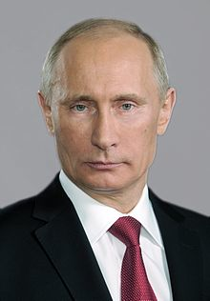
Russian Republic
After the breakup of the Soviet Union, President Boris Yeltsin faced difficulties
  He adopted more capitalist ventures to gain western aid
    In 1998, Russia defaulted on its foreign debt
  In 1994 and again in 1999, revolts broke out in the region of Chechnya
In 1999, Yeltsin resigned and Vladimir Putin became acting president
  Putin was president of Russia until 2008, when his term limit expired
    From 2008-2012, Dmitry Medvedev became President and Putin became Prime Minister
In 2012, Putin ran for another term as president and was sworn in last May
  Medvedev took over as Prime Minister

Slide 17
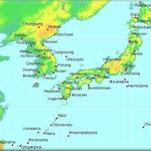
Japan and the Two Koreas

Slide 18
Japan After 1945
Under Douglas MacArthur, the American military government set up two objectives in the occupation of Japan
  1. To destroy militarism
  2. To ensure democratic government
Japan became a constitutional monarchy with elective representatives in the Diet (legislation)
The U.S. introduced economic reforms to promote democracy
  In 1952, the U.S. signed a peace treaty with Japan and they ended their occupation
Between 1950 and 1975, Japan’s gross domestic product soared
  Success was from producing goods for export, and today, technology
  They have a highly skilled work force

Slide 19
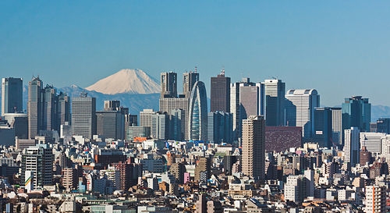
Japanese Politics
Japan is dependent on foreign resources, like oil
After World War II, Japan had to rebuilt relations within Asia
  Japan was a major investor in China and the emerging nations of Southeast Asia
During the Cold War, Japan supported the western alliance

Slide 20
Changing Patterns of Life
In the 1990s, Japan faced its worst economic depression since the 1930s leading to high unemployment but today Japan’s economy is very strong
  They have efficient, modern factories, they are adapted to the latest technology and high-quality exports
Today, most people live in cities, which are hugely overcrowded
  Housing is expensive and space is scarce
Women have legal equality and often control the family finances
  Traditional attitudes toward women keep them in subordinate positions in the workplace
For decades, the Japanese sacrificed family life to work long hours

Slide 21
Japanese Economy

Slide 22
Korean War
After World War II, the Soviet Union and the U.S. agreed to a temporary division of Korea along the 38th parallel latitude
  North Korea was ruled by Kim Il Sung, a communist ally of the Soviet Union
  South Korea was led by Synghman Rhee, an ally of the United States
Both nations wanted to reunite Korea under their own rule
  They both share the same history, language, and culture
North Korea attacked and overran most of the South
  The U.N. organized a force to help South Korea
    General MacArthur led the push back across the 38th parallel almost to China
    Mao Zedong of China helped lead a counterattack southward
In 1953, both sides signed an armistice that held for nearly 50 years
  The Demilitarized Zone (DMZ) was set up near the 38th parallel

Slide 23
North and South Korea Today
Today, North Korea and South Korea have many commonalities like culture, language and history
  The biggest difference between North and South Korea is the economy
After the Korean War, South Korea’s economy has leaped ahead
  By the 1990s, South Korea was an economic leader and the living conditions rose
  The nation then slowly moved from autocracy to democracy
Kim Il Sung’s son Kim Jong Il had taken over North Korea
  North Korea is today developing nuclear power
    North Korea continues to threaten South Korea and Japan by testing missiles
  Today, the leader is Kim Jong Un, Kim Jong Il’s son

Slide 24
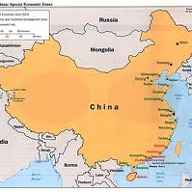
China

Slide 25
Communist China
In 1949, Mao Zedong’s communist forces won and set up the People’s Republic of China and China became a communist country
Until 1979, the U.S. refused to recognize China, seeing it as a communist threat to Asia
  China and the Soviet union disagreed on their Marxist ideology and competed for influence in developing nations
To build socialism and repair the economy, China nationalized all businesses
  The government created five-year plans to develop agriculture and heavy industry
In 1958, Mao launched a program known as “The Great Leap Forward”
  To make agriculture more efficient, he created communes with production quotas and labor brigades
    Was a failure because it actually slowed output, resulting in low-quality goods and low food production
In 1966, Mao launched the Great Proletarian Cultural Revolution
  The goal was to purge China of the “bourgeoisie”

Slide 26
Reform and Repression
Mao Zedong died and was eventually replaced by Deng Xiaoping
  Deng Xiaoping set China on a new path of reform
    He backed a program called the “Four Modernizations” which emphasized agriculture, industry, science, and defense
      Allowed for some capitalist ventures with other countries and also created special enterprise zones, where foreigners could own and operate industries in China
In Beijing and other cities, some supported a democracy movement like those in Eastern Europe
  In May 1989, tens of thousands of demonstrators occupied Tiananmen Square
    The government sent in troops and tanks resulting in thousands of deaths, injuries, and arrests
      Showed that China’s communist leaders were still determined to maintain control

Slide 27
Challenges for China
In 1980s, the government issued a “one-child” per-family policy to reduce population growth
In the late 1990s, inequalities between the rich and the poor grew
  Communist ideology was weakening because more were interested in profit than socialism
Some believe that China uses prison or child labor to produce cheap goods
Some also believe that in Tibet, the indigenous culture was suppressed by the Chinese
  Political dissidents, human rights advocates, and spokespeople for Tibet (like the Dalai Lama) found support from Europe and the United States

Slide 28
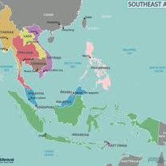
Southeast Asia

Slide 29
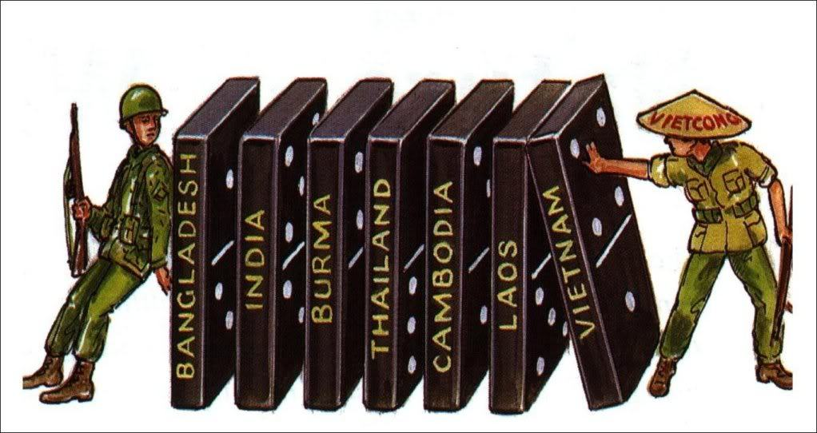
Struggles for SE Asia
Many new nations of Southeast Asia after 1945 struggled because they were caught in the middle of the Cold War
  In order to achieve some unity, ASEAN (Association of Southeast Asian Nations) was created
The Pacific Rim (islands in the Pacific) also face difficulties

Slide 30
Vietnam War
The struggle for Vietnam became part of the Cold War
  At an international conference in 1954, western and communist powers agreed to a division of Vietnam
    Ho Chi Minh (communist) ruled the north and Ngo Dinh Diem (non-communist) ruled South Vietnam
      Cambodia and Laos won independence
The U.S. was afraid that if the communists took over South Vietnam, it would cause noncommunist governments across Southeast Asia to fall to communism (domino theory)
  To stop this, the U.S. gave aid to Ngo Dinh Diem and began bombing targets in North Vietnam in 1964
    North Vietnamese forces launched the Tet Offensive which was a massive attack on the U.S. and South Vietnamese forces
  In 1973, the U.S. began withdrawing American forces and the North Vietnamese took over South Vietnam

Slide 31
The Asian Tigers
The four countries of Taiwan, Hong Kong, Singapore, and South Korea are known as the “Asian Tigers” because they are the industrialized nations of Asia
Taiwan was ruled by China until 1895, when it fell to Japan
  In 1945, Taiwan reverted to China
    When Jiang Jieshi fled China, he set up his nationalist government in Taiwan
      Taiwan developed heavy industry, trade boomed, industrial cities grew, and the standard of living rose
Britain once ruled Hong Kong
  During the Chinese Revolution, many Chinese came to Hong Kong
    It became an industrial and financial center which helped Hong Kong modernize
Singapore won independence from Britain in 1959 and then from Malaya in 1963
  For 30 years, Lee Kwan-Yew was Singapore’s autocratic prime minister
    He supported a free-market economy and many foreigners invested in Singapore

Slide 32
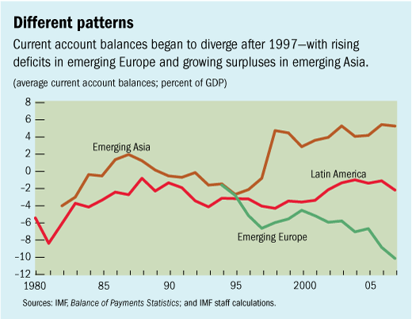
Asian Tigers Economy

Slide 33
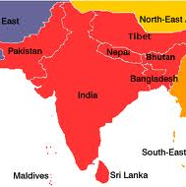
Southwest Asia

Slide 34
Partition of India
After World War II, India was on its way to achieving independence from Great Britain
  Muhammad Ali Jinnah, leader of the Muslim League, insisted that Muslims have their own state, Pakistan
    Riots broke out between Hindus and Muslims
In 1947, Britain partitioned (divided) South Asia
  They created Hindu India and Muslim Pakistan
    Pakistan was made up of two widely separated areas in the northern part of the subcontinent that had large Muslim populations
In 1947, millions of Hindus and Muslims mass migrated across the border, leading to violence
  Mohandas Gandhi tried once more to restore peace
    On January 30, 1948, Gandhi was shot and killed by a Hindu extremist
Hindu-Muslim tensions persisted in the region

Slide 35
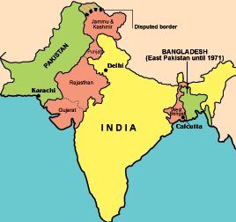
Pakistan after Partition
After independence and the partition of India, Pakistan faced severe problems
  1. Military leaders seized power and ruled as dictators
  2. Ethnic rivalries fueled conflict
  3. New nations of West Pakistan and East Pakistan were separated by India
    People of both regions were Muslim, but their cultures differed
      In East Pakistan, Bengalis outnumbered the Punjabis, yet Punjabis dominated the government and economy
In 1971, Bengalis in East Pakistan declared independence for Bangladesh or “Bengal Nation”

Slide 36
India
India built on the British system of law and government
  India’s constitution set up a federal system where power is divided between a strong central government and smaller local governments
Majority of Indians are Hindu, but millions of others are Muslim, Sikh, Christian, or Buddhist
  For 40 years after independence, the Nehru family led India
    India became an industrial power but lacked oil and natural gas
Rapid population growth hurt efforts to improve living conditions
Discrimination based on the caste system continued
  After independence, women gained the right to vote along with other legal rights
    Some educated women, like Indira Gandhi, served in political office

Slide 37
Tensions in South Asia
During the Cold War, India welcomed economic aid from both the Soviet Union and the U.S. but remained nonaligned
  Pakistan, feeling threatened by India and the Soviet Union, accepted U.S. aid
Border conflict erupted over Kashmir, in the Himalayas
  The Hindu monarch of Kashmir decided to join India, but the Muslim majority wanted to be a part of Kashmir
Ethnic tensions have fed guerilla warfare on the island nation of Sri Lanka
  Most Sri Lankans are Buddhist who speak Singhalese
  The Tamil-speaking Hindu minority faced discrimination and rebels have fought for a separate nation

Slide 38
Pakistan and Bangladesh Today
Since 1971, Bangladesh struggled to rise out of poverty but geography has stood in the way
  Country subject to floods by monsoon rains and cyclones
  Many people live below the poverty line
In Pakistan, General Pervez Musharraf, the military took over the government and suspended the constitution
  To modernize, Pakistan nationalized major industries
    They have borrowed heavily from foreign lenders, but their debt service (paying interest on loans) take up 40% of the nation’s budget

Slide 39
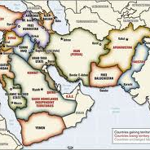
Middle East

Slide 40
Linking the Modern Middle East
Linked by Islam and a common heritage
  Islam has shaped the Middle East for over 1300 years
    The Qu’ran and Sharia law provide guidance on all aspects of life
By the 1970s, failed development and oppressive regimes have led many Muslims to call for a return to Sharia
  Sharia law is the moral code and religious law of Islam
    It addresses many topics like crime, economics, politics, prayer, fasting, etc.
    It is considered the infallible law of God
Muslim fundamentalists blamed economic and social ills as well as imitation of western models for their current issues
  Some called for jihad meaning “struggle” but it is defined as a vigorous, emotional crusade for an idea or principle
    Islamic fundamentalists don’t reject modernization, just westernization
      Argued that a renewed commitment to Islam was the only way out of their current issues

Slide 41
Resources: Oil and Water
Oil is unevenly distributed
  Few countries have large oil reserves
    Countries that are rich in oil use profits to boost their country’s economy and standard of living
  OPEC (Organization of Petroleum Exporting Countries) in 1973 issues an oil embargo
    Showed that oil can be used as a powerful economic and diplomatic weapon
Most of the region has limited rainfall and water is a scarce resource
  Growing populations have increased the demand for water
  Often times, one nation’s water resources lie in another country
    Oil-rich countries have built desalinization plants that convert salty sea water to fresh water
    Individual nations have built dams on rivers, which has led to conflict

Slide 42
Politics during the Cold War
During the Cold War, each of the superpowers made alliances in the Middle East
  The U.S. supported non-communist regimes in Turkey and Iran
Some Arab nations turned to socialism as a way to end foreign economic control and to modernize rapidly
  Iraq, Syria and Libya became Soviet client states
Most Middle Eastern nations developed authoritarian governments who suppressed citizens
  Some maintained hereditary monarchies but have modernized as well

Slide 43
Conflicts in the Middle East
Arab-Israeli Conflict
  In 1947, the United Nations agreed to partition Palestine to create a Jewish homeland of Israel
    Both Muslims and Jews consider this land their homeland
  Arab states launched a military attack against Israel and the Israeli forces struck back
    The conflict displaced over 700,000 Arabs from Palestine
Lebanon
  Tensions increased among Christian and Muslims groups, especially after large numbers of Palestinian refugees entered the country
Iran-Iraq
  In the 1980s, Iraqi dictator Saddam Hussein seized a disputed border area from Iran
    Both sides attacked international tankers and oil fields in the Persian Gulf
      The U.S. sent naval forces to protect shipping interests there
  In 1990, Iraqi troops invaded Kuwait
    A coalition of American, European, and Arab forces were sent to drive the troops out

Slide 44
Current Issues
The Middle East is still a hotbed of conflict
  There are many nationalist conflicts, clashes between religious and secular groups, competition for water resources, etc.
  Oil guarantees that foreign powers will continue to intervene in the Middle East
Many Palestinians who were displaced during the Arab-Israeli conflict demand return to their homeland
Following the al-Qaeda attacks on 9/11, the U.S. has declared a war on terrorism and lead wars in the region
The “Arab Spring” refers to democratic uprisings that occurred independently and spread across North Africa and the Middle East beginning in 2011
  It began in Tunisia and spread to Egypt, Libya, Syria, Yemen, Bahrain, Saudi Arabia and Jordan

Slide 45
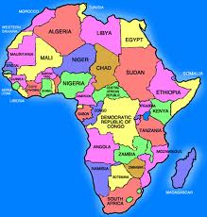
Africa

Slide 46
Colonial Independence
In 1945, Britain, France, Belgium and Portugal controlled almost all of Africa
  Under colonization, Europeans introduced new crops, technologies, and cash economies. They also built railroads, harbors, roads and cities.
  Colonial governments had an impact on health care and education in Africa even though most Africans had limited access to these things
The rising tide of nationalism swept across Africa in the years following WWII
  Europe was growing tired of maintaining the control over their colonies and started adopting new political reforms leading to gradual independence

Slide 47
Post-Colonial Africa
During the “great liberation” of the 1950s-1960s, more than 50 new nations were created
  During the early decades after independence, the new nations took different paths to modernization
After liberation, there were many struggles in Africa
  Countries were still economically dependent on the west
  New African nations inherited borders drawn by colonial powers which caused many problems
    Countries now included people from diverse and conflicting ethnic groups or some nations split ethnic groups between two separate nations

Slide 48
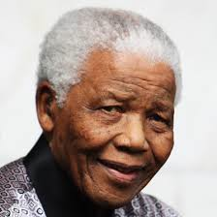
South Africa’s Struggles
In 1910, South Africa won independence from Britain but they faced many struggles after independence
  Whites, who made up only 20% of the population, controlled most resources and land
    The white government passed racial laws to keep the black majority subjugated
      They created apartheid, which is the separation of races
Nelson Mandela was an African nationalist who led the fight against apartheid even while imprisoned for 27 years
  Reforms were made beginning in 1989
  Finally in 1994, South Africa held its first multiracial elections
    They elected Nelson Mandela as the first president of a new, democratic South Africa

Slide 49
Cold War in Africa
Although many nations supported the non-aligned movement, some did choose sides during the Cold War
  These Cold War rivalries affected local conflicts within Africa
    There was a long, bloody war between Ethiopia and Somalia
  The Cold War left a painful legacy
    Weapons supplied from both the Soviet Union and the U.S. came into the hands of traditional tribes or clans or into the hands of modern militias and guerrilla forces
      This spread violence throughout Africa

Slide 50
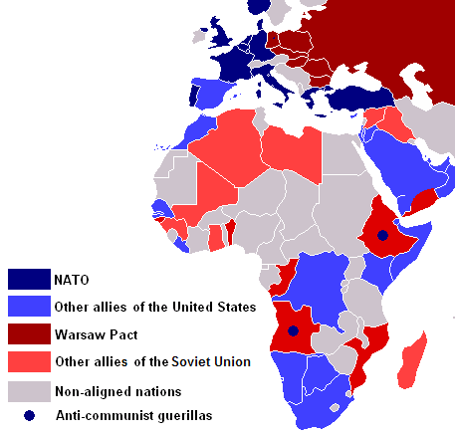
Cold War in Africa

Slide 51
African Unity
Many nations of Africa have joined both regional and global organizations
  In 1963, they set up the Organization of African Unity
    It promoted cooperation among members, supported independence, and sought peaceful settlements of disputes
    They also set up the African Development Bank to put capital into development programs
  Many joined the United Nations
    The UN has had a major impact in Africa by giving aid for economic development and natural disasters as well as providing peacekeeping during times of conflict

Slide 52
Current Issues in Africa
Divisions: African nations are plagued by conflict left behind from colonialism; some forced people together from different ethnic groups
Civil War: Many countries have faced civil wars, some resulting in genocide (Example: Sudanese Conflict)
Dictatorships: Many countries have turned to a single-party system that has led to authoritarian rule
Urbanization: Has led to weakened kinship ties
Cash Crops: In order to boost the economy, some governments sell cash crops leading to exporting of goods and a food shortage for the African people
Desertification: Drought has led to desertification, or the spreading of desert-like areas
Deforestation: Rain forests have come under attack with the need to grow cash crops and exporting trees
AIDs: In 2008, it was estimated that approximately 7 out of 10 people in Sub-Saharan African died from AIDs

Slide 53
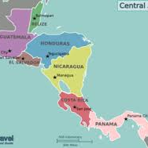
Central America

Slide 54
Cold War in Central America
The U.S. wanted their sphere of influence to be in the Americas (Monroe Doctrine, Roosevelt Corollary, etc.)
  During the Cold War, the U.S. intervened repeatedly in Latin America
    They backed anti-communist regimes
Many Latin Americans opposed U.S. economic and military intervention

Slide 55
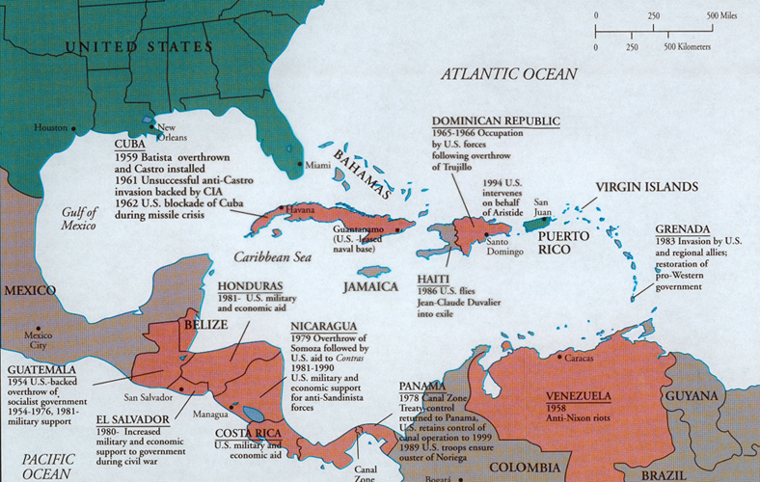
Cold War in C. America

Slide 56
Mexico
Mexico has major major reforms and changes since World War II
  Ejidos (peasant cooperatives) were created to redistribute land to the rural poor
    They were unsuccessful because most people are still living in poverty
  Democratic reforms have been made to repair the government structure
  The economy has grown and now Mexico is linked closely with the economies of the U.S. and Canada through NAFTA
    Despite economic growth, many Mexicans remain poor
      Maquiladoras have cropped up along Mexico’s northern border, using cheap labor to produce goods

Slide 57
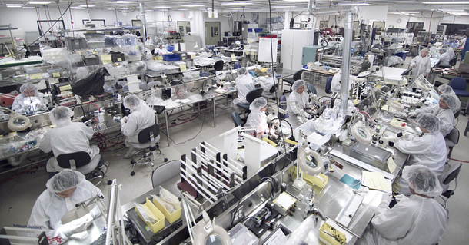
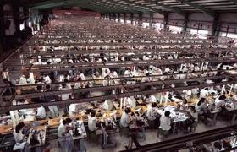
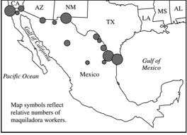
Maquiladoras

Slide 58
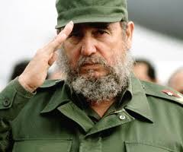
Cuba
In 1959, Fidel Castro led a guerrilla army against the government
  Afterwards, Castro turned Cuba into a communist state
    He nationalized businesses and put most land under government control
The Cuban Revolution alarmed the U.S. because Castro turned to the Soviet Union for aid
  In 1961, the U.S. led the Bay of Pigs invasion to overthrow Castro but it was unsuccessful
  In 1962, the U.S. issued an embargo on trade with Cuba
  In October 1962, the Soviets built nuclear missile bases in Cuba
    The threat of these nuclear weapons launched the Cuban missile crisis where the U.S. and Soviet Union stood on the brink of nuclear war

Slide 59
Central America and the Caribbean
Like Cuba and Mexico, Nicaragua also had a revolution, which came in the late 1970s
  Rebels (Sandinistas) called for an end to the dictatorial regime of the Somoza’s
    Fearing a communist regime, President Reagan secretly backed contras (guerrilla fighters) against the rebels
Guatemala, El Salvador, and Haiti also underwent major economic and political changes after World War II
Most countries in Central America and the Caribbean remain poor today
  Most rely on a single export or industry

Slide 60
Sources of Unrest in Latin America
Social Structure
  The upper classes were mostly descended from Europeans
Competing Ideologies
  Some countries turned to communism during the Cold War
    During the 1960s and 1970s, guerillas and urban terrorists battled repressive governments in Latin America
Regional Organizations
  The Southern Common Market (Mercosur) linked some of Latin America’s most productive economies
  The Organization of American States (OAS) was formed in 1948 to “promote democracy, economic cooperation and human rights”
Social Issues
  Illegal drug trade, poverty, and access to education are all issues in Latin America

Slide 61
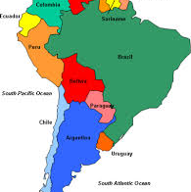
South America

Slide 62
Brazil
Brazil had faced unique challenges after the end of Portuguese colonization
  It has a very high population, with 90% of Brazilians living within 200 miles of the coast
    To redistribute population, they created a capital inland called Brasilia
75% of Brazilians live in cities, with the majority of people living in poverty
  Favelas, or slums, ring the major cities
Brazil has also faced political issues with dictators and military rule
  In 1989, Brazil hosted democratic elections for a republic led by a president
Brazil has had major economic growth and it is one of the top developing countries in the world (BRICS)
  They have moved away from a single export by diversifying their economy

Slide 63
Argentina
In the early 1900s, Argentina was the largest Spanish-speaking nation in the world and the richest in Latin America
  When the Great Depression struck, it crippled Argentina’s economy and led to social unrest and military rule
In 1946, Juan Peron was elected president
  He was an authoritarian ruler and many people fled Argentina
  He was overthrown by the military in 1955
    Peron was re-elected president in 1973 but once again was forced to flee by another military coup
Democracy was restored to Argentina in 1983
  Since then, Argentina has been growing and is re-establishing its strong economy

