Slide 1
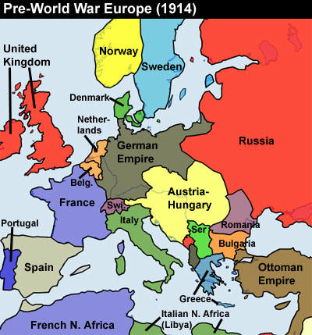
Central europe

Slide 2
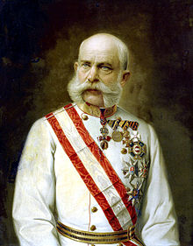
Hapsburg Empire
In 1800, the Hapsburgs were the oldest ruling family in Europe
Ruled over Austria, Bohemia, Hungary, and parts of Romania, Poland, Ukraine and Northern Italy
Hapsburgs ruled over a multinational empire
Most were Slavic groups
Many of these ethnic groups wanted nationalism, causing tension within the empire
When 18-year old Francis Joseph inherited the throne
Made limited reforms like granting a new constitution and set up a legislature

Slide 3
Austria-Hungary
Austria’s defeat against Prussia brought pressures to change
Made an agreement to create a new political power known as the Dual Monarchy of Austria-Hungary
Austria and Hungary were separate states with their own constitution and parliament
Francis Joseph ruled over both as emperor of Austria and king of Hungary
The impact was that it combined two large, powerful empires
Some nationalist groups resented the Dual Monarchy

Slide 4
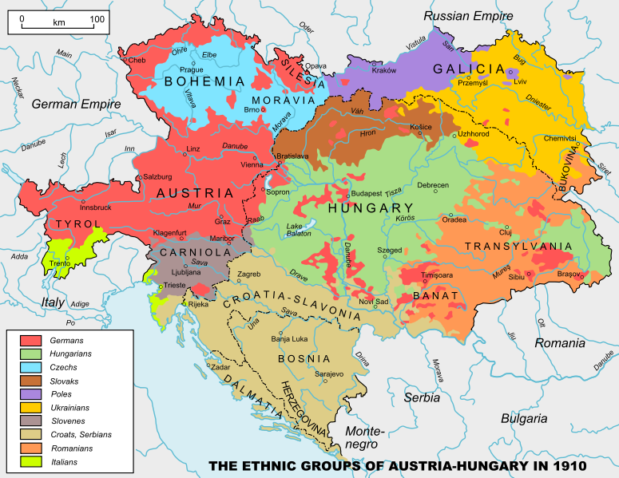
Ethnic Groups of Austria-Hungary

Slide 5
The Balkans
The Ottoman Empire also ruled over a multinational empire
Stretched from Eastern Europe and the Balkans to North Africa and the Middle East
Known as the “Balkan powder keg”
Within the Balkans, nationalist groups revolted
European countries were fighting against the Ottoman Empire trying to win land
Nationalism grew in the Balkans because of the downfall of the Ottoman Empire “the sick old man of Europe”
Serbia won independence in 1817 and southern Greece won independence in the 1830s

Slide 6
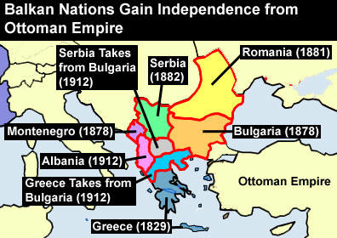
Crumbling of the Ottoman Empire

Slide 7
Russia
In 1915, Russia was the largest, most populous nation in Europe
Had immense natural resources
Russia was home to many ethnic groups
Russian czars needed to modernize but didn’t want to undermine their absolute power
So, Russia fell behind in industrialization
When Nicholas I took the throne, he had to suppress revolts and retain absolute power
Used police spies, banned books, and exiled critics
Embraced three pillars of Russian absolutism:
Orthodoxy, Autocracy, and Nationalism

Slide 8
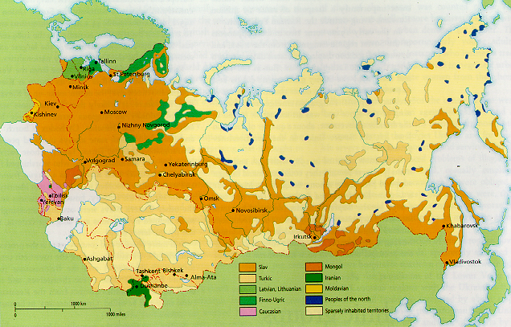
Ethnic Groups of Russia

Slide 9
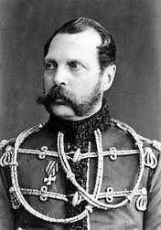
Changes in Russia
Alexander II inherited the throne in 1855
Alexander II agreed to make reforms
Alexander II freed all serfs
Caused some problems for the serfs because they couldn’t afford to buy the land they had worked on
Some moved to cities
Set up reforms for local governments
Created elected assemblies called zemstvos
Made local governments responsible for roads, schools and agriculture

Slide 10
Reaction to Reforms
Socialism began to spread to Russia
A revolutionary group calling themselves “The People’s Will assassinated officials and plotted to kill the czar
In March 1881, terrorists hurled two bombs at Alexander II’s carriage and assassinated the czar
Alexander II’s son, Alexander III responded by going back to the harsh methods of Nicholas I
Launched a program of “Russification”
Aimed at suppressing the cultures of non-Russia people within the empire; led to anti-Semitism
One language (Russian) and one church (Russian Orthodox Church)
Persecution of Jews
Limited the number of Jews in certain positions
Encouraged pogroms, or violent mob attacks on Jews

Slide 11
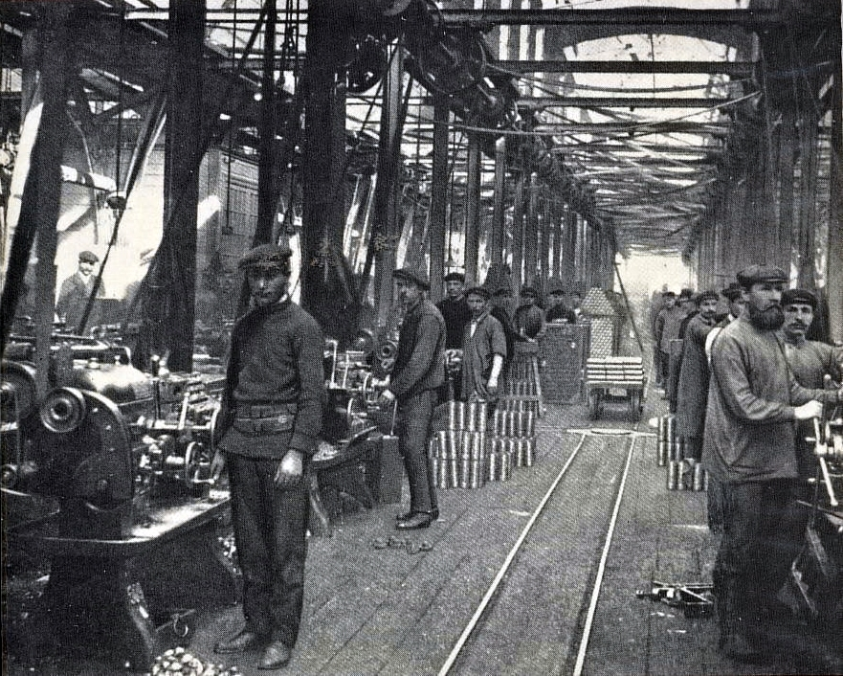
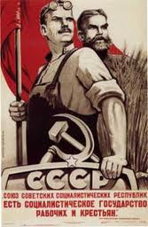
Russian Industrialization
Russia entered in the Industrial Age
Encouraged railroad building, steel production
Built Trans-Siberian Railroad which linked Russia to the Pacific Ocean
Industrialization caused many problems
Nobles and peasants opposed it; Dangerous working conditions; Rise of socialism

Slide 12
Crisis and revolution
War broke out between Russia and Japan in 1904
Russia was losing and in the cities there were protests and workers’ strikes
On Sunday, January 22, 1905 an Orthodox priest Father George Gapon organized a protest march in St. Petersburg
The czar fled the palace and called the soldiers to stop the riots
The “Bloody Sunday” protest parade turned violent and many civilians were killed
This “Bloody Sunday” riot marked a turning point for Russians
Killed the people’s faith and trust in the czar
Peasants and workers revolted

Slide 13
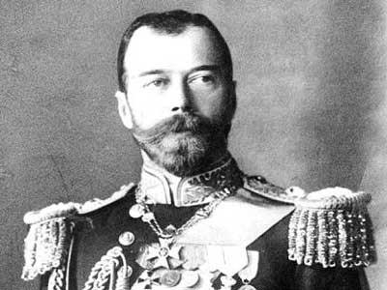
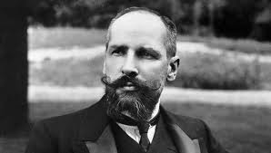
Reforms
Czar Nicholas II tried to make reforms
Summoned a Duma, or elected national legislature
Appointed a Prime Minister, Peter Stolypin
Strengthened the zemstvos and improved education
Assassinated in 1911

