Slide 1
Revolutions Around The World

Slide 2
Ideologies
Period of unrest after 1815 was caused by opposing ideologies
Conservatives:
Includes monarchs, noble landowners, and church leaders
Goal was to restore monarchies and the old order
Fought against revolutionary ideas and natural rights
Liberals:
Includes nationalists, Enlightened thinkers, ethnic groups
Goal was to establish a homeland for people of a common heritage.
Fought against absolute monarchs and church control

Slide 3
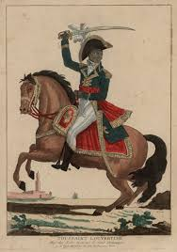
Latin America
Napoleon’s invasion of Spain in 1808 sparked widespread rebellion in Latin America
France controlled Haiti in the 1700s
Toussaint L’Ouverture led a rebel slave revolt
Haiti declared its independence from France in 1804
In 1820, Haiti became a republic
Reasons for discontent that led to revolution
1. Peninsulares dominated Latin America
2. Mestizos and mulattoes were discontented
3. Dissatisfaction with Spanish rule in Latin America

Slide 4
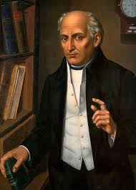
Latin America
Mexico
In Mexico, Father Miguel Hidalgo and Jose Morelos worked towards independence
In 1820, Augustin de Interbide became emperor Augustin I
In 1821, Mexico became a republic
South America
There were also movements in South America against foreign rule
Brazil became independent of Portuguese rule in 1822
Brazil remained a monarchy from 1822-1889

Slide 5
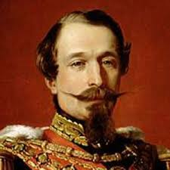
Europe
MORE FRENCH REVOLUTIONS!! WHY!? (Remember the Congress of Vienna?)
French Revolution of 1830
In 1830, Charles X was ruling France as an absolute monarch
Rebels took over Paris and Charles X fled France
Louis Philippe became King
French Revolution of 1848
“February Days” riots begin in Paris
Louis Philippe abdicates the throne
Second Republic created and new constitution made
Louis Napoleon elected president and proclaimed emperor in 1852 as Napoleon III

Slide 6
Europe
Revolutions occurred in Europe in Belgium, Poland, Austria, Italy, Prussia, Germany.
Belgium: Became independent from the Dutch in 1831.
Poland: Uprisings in 1830 did not lead to independence.
Austria: Revolts spread through the Hapsburg empire of Austria. Austrian government made reforms.
Italy: Nationalists wanted to end Austrian empire in Italy. Ended abruptly.
Prussia: Liberals forced King Frederick William IV to a constitution. Only lasted one year.
Frankfurt: In 1848 delegates from the German states met at Frankfurt Assembly but it dissolved one year later. Unable to achieve unification.

