Slide 1
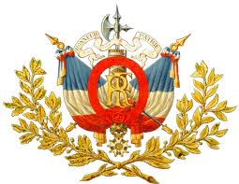
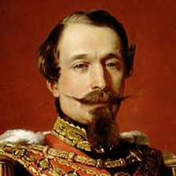
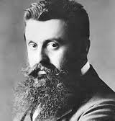
Division and Democracy in France

Slide 2
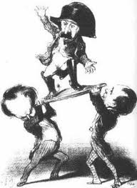
France Under Napoleon III
Napoleon III led the Second Republic in France.
They had a constitutional monarchy, but Napoleon III really ruled as a dictator.
Napoleon III promoted investment in industry and railroad building.
Labor unions granted public education and public health programs.
Otto von Bismarck manipulated Napoleon III into the Franco-Prussian War.

Slide 3
Challenges of the Third Republic
Napoleon III was captured during the Franco-Prussian War.
Republicans set up a provisional government, the “Third Republic”
In 1871, an uprising broke out in Paris and rebel socialists set up the Paris Commune.
Civil war between the Communards and the National Assembly ended when 20,000 Communards were murdered.
The Third Republic set up a two-house legislature.
The two houses elected a president, who had little power.
The Premier, or prime minister, had the most power in France.
The Third Republic had many political parties.
In order to control the voting in the legislature, parties formed coalitions with other parties.

Slide 4
The Dreyfus Affair
In 1894, a French army officer, Alfred Dreyfus, was falsely accused of spying for Germany because he was Jewish.
Against the facts, Dreyfus was convicted and condemned to life imprisonment.
Royalists, ultranationalists and Church officials believed Dreyfus was guilty.
Republicans and liberals supported Dreyfus
In 1898, French novelist Emile Zola wrote an article called J’Accuse! Charging the army and government for suppressing the truth.
Zola was charged with libel

Slide 5
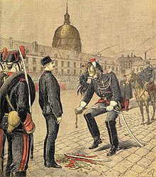
The Dreyfus Affair: Impact
Reflected anti-Semitism in Europe.
The Dreyfus Affair and the pogroms in Russia stirred Theodor Herzl, a Hungarian Jewish journalist living in France.
He launched the modern Zionist movement.
The Zionist movement called for Jews to form
their own separate Jewish state in Palestine.

Slide 6
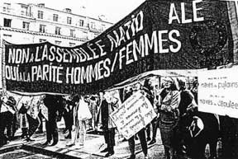
Reforms in France
By 1900, France achieved some reforms.
Passed laws regulating wages, hours, and safety conditions for workers.
In 1905, they passed a law to separate the Catholic Church and the government.
By the 1890s, a women’s rights movement began in France.
They would not receive the right to vote until after World War II.

