Slide 1
Encounters in Asia

Slide 2
Review!
Why did Europeans want to reach Southeast Asia?
How did Europeans travel to Southeast Asia?
What technologies helped Europeans reach Southeast Asia?

Slide 3
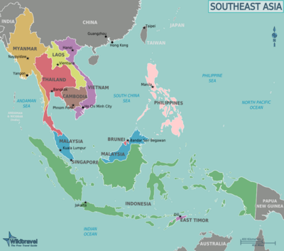

Slide 4
SOUTHEAST ASIA and India
A region composed of a mainland and scattered islands.
Many religions dominated Southeast Asia
Hinduism
Islam
Buddhism
India greatly influenced Southeast Asia
Spread their culture in Southeast Asia
Brought prosperity into the region
By the late 1700s, the British dominated trade within India

Slide 5
European Trade with China
The Ming Dynasty ended its overseas explorations in the mid-1400s
Portuguese traders reached China by sea in 1514
Demanded payment in gold or silver
The Ming Dynasty had very strict trading limits on the Europeans
Could only trade at certain posts under supervision of imperial officials
Could only trade during a trading season
Some scholars, like Matteo Ricci, made a positive impression on Ming China by learning to speak Chinese and adopted Chinese dress

Slide 6
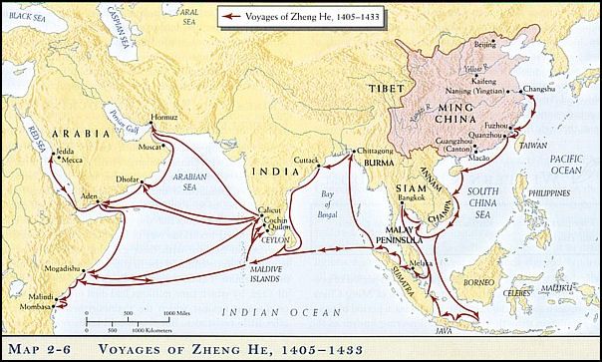
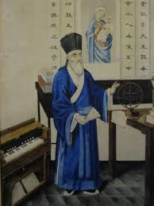
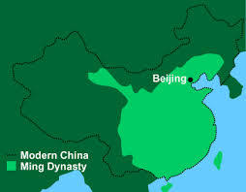

Slide 7
Manchu Conquest
In the early 1600s, the Ming dynasty was decaying.
The Manchu invaders pushed north and in 1644 they seized Beijing and made it their capital.
Manchus set up the Qing Dynasty and tried to preserve their distinct identity by implementing policies upon the Chinese
Barred intermarriage between Manchus and Chinese
Could not practice Chinese cultural traditions like foot-binding

Slide 8
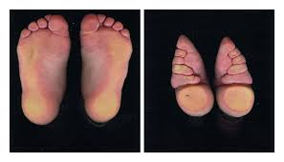
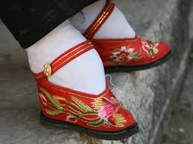
Foot binding

Slide 9
Qing Dynasty
Chinese economy expanded under the Qing.
The Qing maintained the Ming policy of restricting foreign traders.
In 1793, Lord Macartney arrived in China at the head of the British diplomatic mission.
He was received poorly by the Chinese Emperor because of many misunderstandings.
1. Brought samples of British goods the Qing thought were poor gifts
2. Macartney refused to bow to the emperor
3. Macartney offended the Chinese by speaking of the British superiority

Slide 10
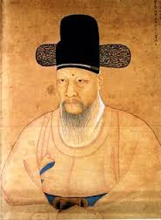
Korea and Isolationism
Like China, Korea restricted outside contacts in the 1500s and 1600s.
The Choson dynasty firmly embraced Confucian ideas who looked down on foreign traders.
Two events led to the Korean policy of isolationism
1. A Japanese invasion in the 1590s devastated Korea
2. In 1636, the Manchus conquered Korea before taking over China
Korea chose isolationism, excluding all foreigners except the Chinese and a few Japanese.

Slide 11
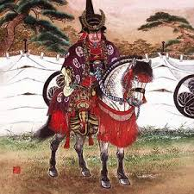
Japan and Foreign Traders
In 1543, the Portuguese reached Japan and later came the Spanish, Dutch, and English.
The Japanese welcomed western traders and adopted European ideas.
Japan changed its ideas on dealing with Europeans.
Saw the newcomers as an invading force and competition
By 1638, the Tokugawas had barred all western merchants and forbidden Japanese to travel abroad
They outlawed the building of large ships, ending foreign trade

