Slide 1
Geography

Slide 2
5 Themes of Geography
Location: ___________________
_____________ Location: the exact location on the Earth’s surface based on latitude and longitude
_____________ Location: in relation to another place
Place: The characteristics that make a location unique
Regions: Areas that share characteristics
__________________: How and why people/things move
Human-Environment Interaction: Relationship between _____________________________________________

Slide 3
___________________: Show the image of the Earth onto a flat surface
Planar Projection: shows the Earth centered around _______________________
Cylindrical Projection: based on the projection of the globe onto a cylinder; centered on the ________________ distorts near the poles
_______________ Projection: based on placing a cone over part of the globe; indicates distances and directions fairly accurately
Mercator Projection: Accurately displays _____________ and ______________________________________

Slide 4
Planar Projection

Slide 5
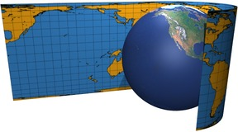
Cylindrical Projection

Slide 6
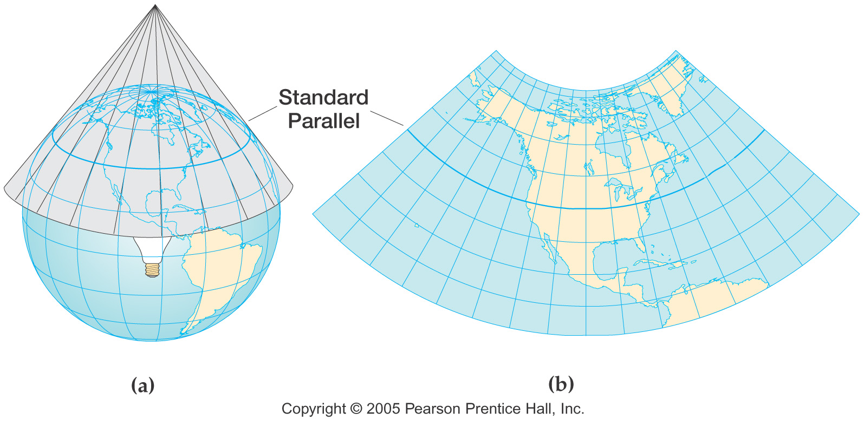
Conic Projection

Slide 7
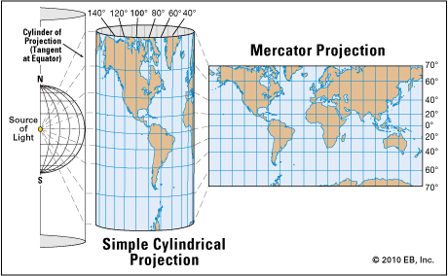
Mercator Projection

Slide 8
Determining Location
Latitude: Lies that circle the Earth parallel to the Equator measured ___________________________ of the Equator
___________________: Measured at 0 degrees latitude
North and South ____________: Measured at 90 degrees latitude
______________________: Circle the Earth from Pole to Pole measured east and west of the Prime Meridian
Prime Meridian: Measured at __________________________
____________________: Helps determine absolute location using placements of latitude and longitude

Slide 9
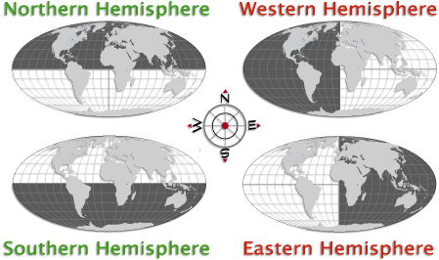
Determining Location
Hemispheres: _______________________
Northern Hemisphere: North of ____________
Southern Hemisphere: South of ______________
Eastern Hemisphere: East of ___________________
Western Hemisphere: West of ___________________

Slide 10
Types of Maps
Physical Map: Shows _________________________ ____________________________________________
____________________ Map: Shows boundaries and locations of politics units like countries, states, and cities
Qualitative (_________________) Map: Focused on a kind of information or a single area
Use colors, symbols, lines, dots, etc. to show specific ideas

Slide 11
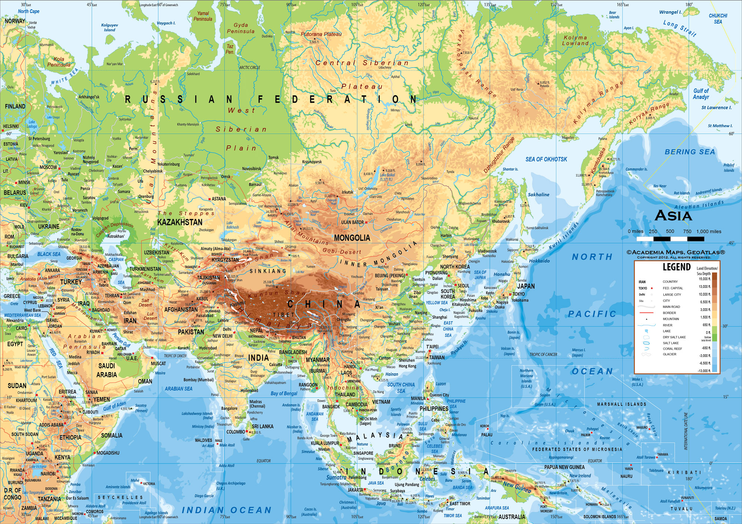
Physical Map

Slide 12
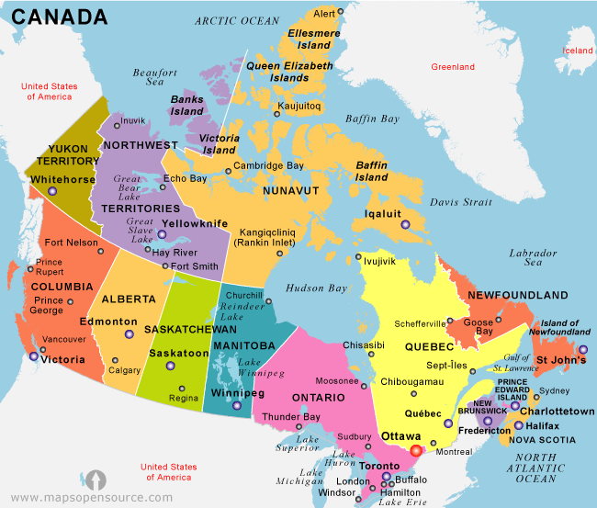
Political Map

Slide 13
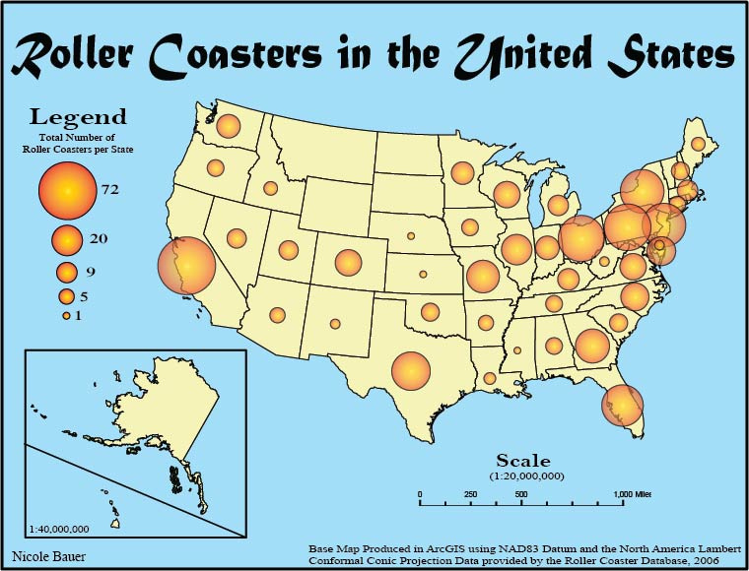
Qualitative (Thematic) Map

Slide 14
Reading Maps
___________: Lists and explains the symbols, colors, and lines used on the map, also called a ___________
Compass Rose: Indicates directions usually including the four cardinal directions (__________________________) with the points of a star
Scale Bar: Shows the relationship between map measurements and ________________________________ _________________________________________
By __________________________ on the scale bar, you can calculate how many miles or kilometers are represented per inch or centimeter

Slide 15
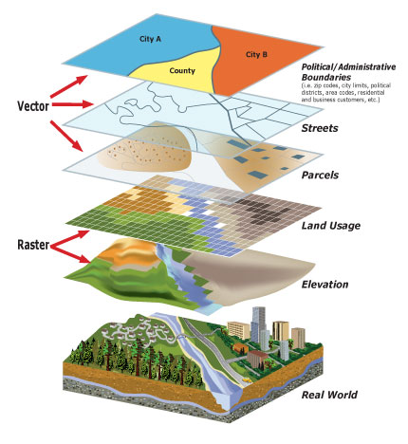
Geographic Information Systems (GIS)
Modern technology has changed the way maps are made
Most cartographers use software called ___________________ _______________________(GIS)
Uses data from __________________________________________ ______________________________
Converts into a digital code and then produces a map

Slide 16
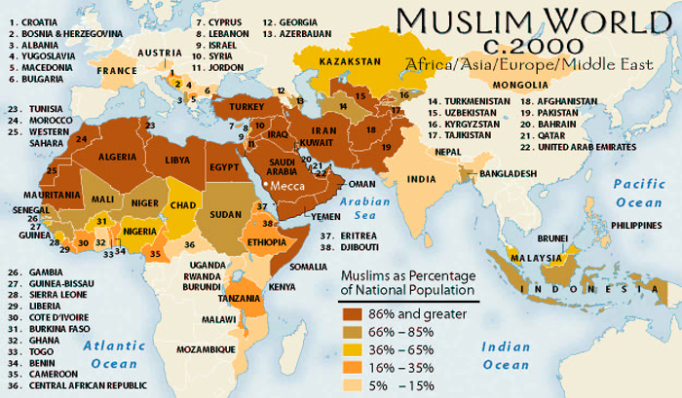
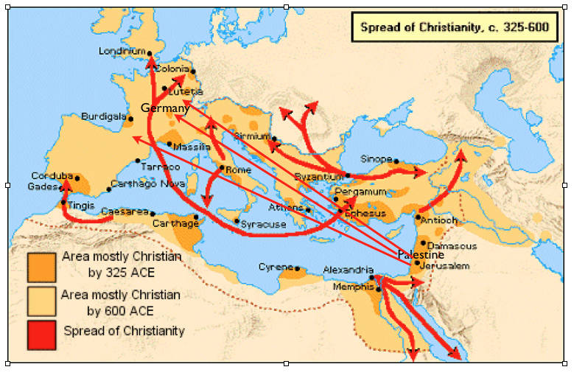
Human Geography
People shape the world in which they live, they settle in certain places but not others.
People __________________________ the environment they live in
___________________: Include a collection of countries whose people practice the same religion and speak a common language (a region that ______ ________________)
Cultural Diffusion: The way that cultural innovations and ideas ______________________________________________

Slide 17
Locate and Label the Following

Slide 18
Map Identifications- Map Features
Compass Rose
Scale Bar
Equator
Type of Projection

Slide 19
Map Identifications- Physical Features
Pacific Ocean
Atlantic Ocean
Indian Ocean
Mediterranean Sea
Persian Gulf
Caribbean Sea

Slide 20
Map Identifications- Political and Culture Regions
South Asia
South America
North Africa
Oceania
Sub-Saharan Africa
Middle East
Western Europe
Latin America
North America
Eastern Europe
Central America
East Asia
Russia
Southeast Asia

