Slide 1
Impacts of Imperialism

Slide 2
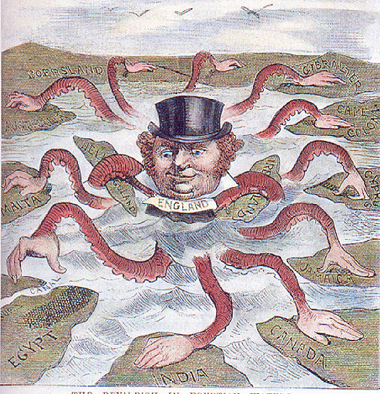

Slide 3
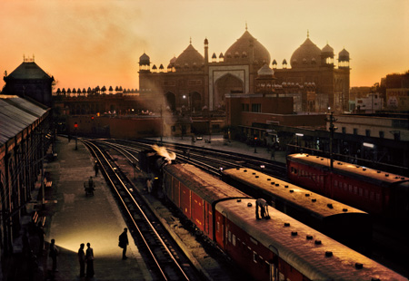

Slide 4
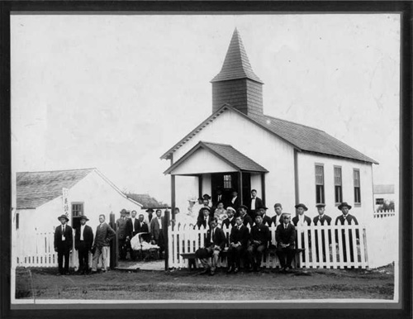

Slide 5
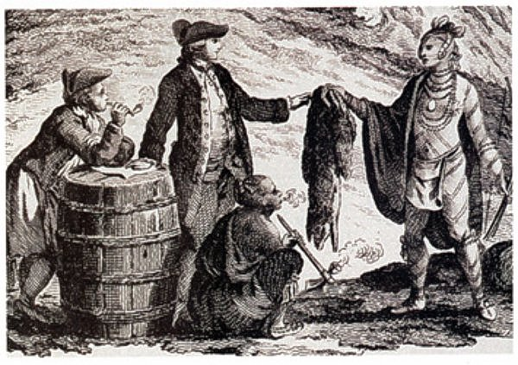

Slide 6
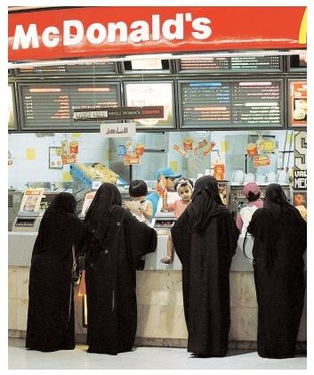

Slide 7
Economic Impacts
Global economy emerged during the Age of Imperialism
From the Industrial nations: manufactured goods, technology, westernization, modern banking systems
From Asia, Africa, and the Americas: Agricultural goods, natural resources and labor
New world economy disrupted local economies in Africa and Asia
Economic dependence on industrialized countries

Slide 8
Cultural Impacts
Westerners forced locals to accept modernization, western ideas, government, technology and culture
Missionaries built schools and hospitals and converted locals to Christianity
Often led to the destroying of local cultures
Western culture also affected with the introduction of cultural practices and local products

Slide 9
Political Impacts
Imperial powers claimed and conquered large empires
Imperialism caused political tensions among the European powers as they competed for land
Sometimes they disrupted traditional political units and replaced them with their own governments
Resistance to imperialism sparked nationalist movements in Africa, Asia, and the Americas

Slide 10
Pros and Cons
What are some positive effects of imperialism?
What are some negative effects of imperialism?

Slide 11
Essay Styles
Remember: For all essays you need an INTRODUCTION and CONCLUSION. Remember to say WHICH PERSPECTIVE YOU ARE TAKING (western powers or natives). Give BOTH positives and negatives!
Essay Style 1: (Compare and Contrast)
Body Paragraph 1: Positives
Body Paragraph 2: Negatives
Body Paragraph 3: Both
Essay Style 2: (Topically)
Body Paragraph 1: Topic One (Example: Westernization)
Body Paragraph 2: Topic Two (Example: Global Economy)
Body Paragraph 3: Topic Three (Example: Global Empires)
Essay Style 3: (Categorically)
Body Paragraph 1: Economic Impacts
Body Paragraph 2: Political Impacts
Body Paragraph 3: Cultural Impacts

