Slide 1
Life in a Totalitarian State

Slide 2
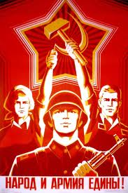
Controlling Lives
Terror
Stalin used terror to threaten people into submission
If they spoke out against Stalin’s regime they could be sent to forced labor camps
Propaganda
Stalin used propaganda to gain support for his communist regime
War on Religion
The communist party eliminated state religion in the Soviet Union and favored atheism
Russian Orthodox churches were burned and priests were punished

Slide 3
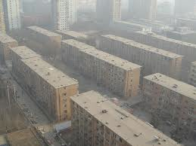
Changes to Soviet Society
Communist party members were at the top of society
Communist party members had more benefits than others
Free education for all
Low standard of living
Free medical care for all
Women had equality under the law
Scarce housing

Slide 4
Controlling the Arts
Socialist realism
A form of art propaganda depicting the glories of communism and the Soviet Union
Censorship
All writing was censored by the state
Those writers who wrote negatively about communism, Stalin, or the Soviet Union would be punished

Slide 5
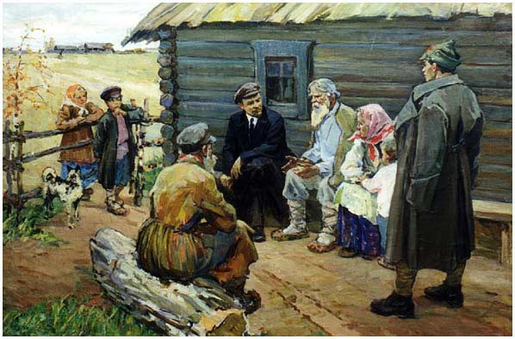

Slide 6
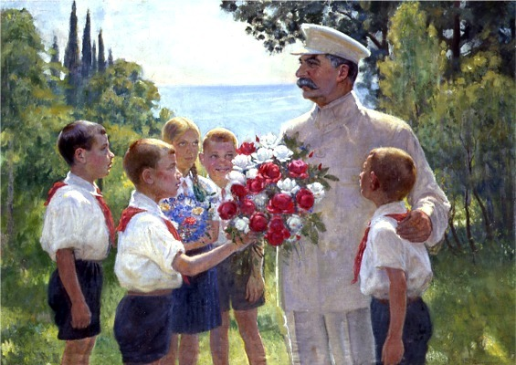

Slide 7
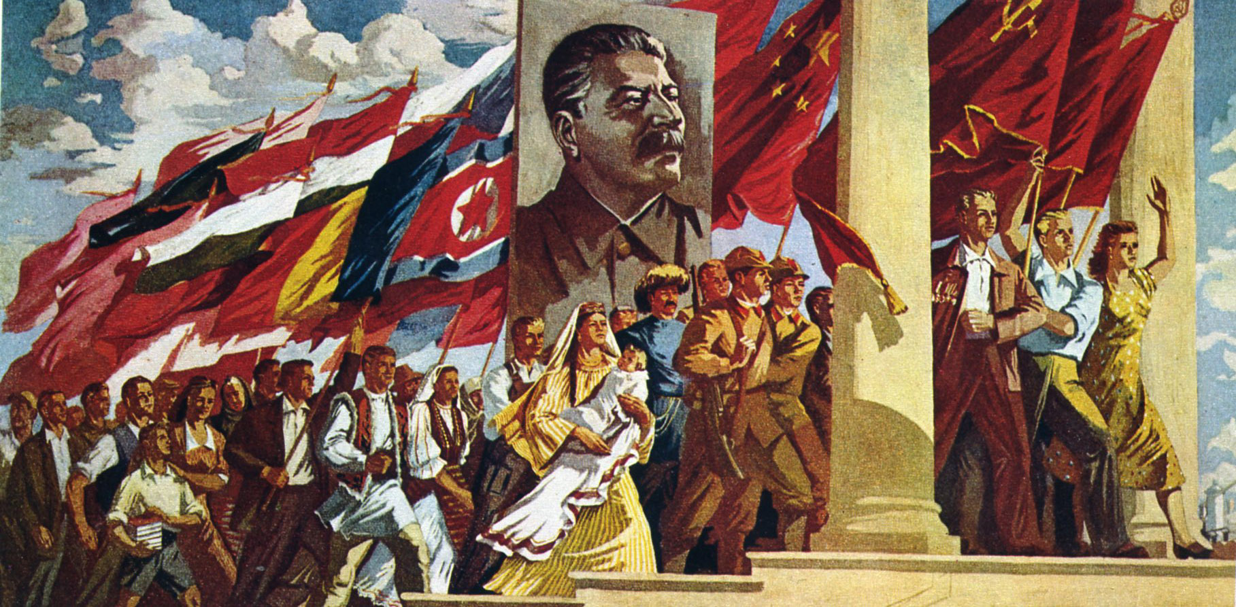

Slide 8
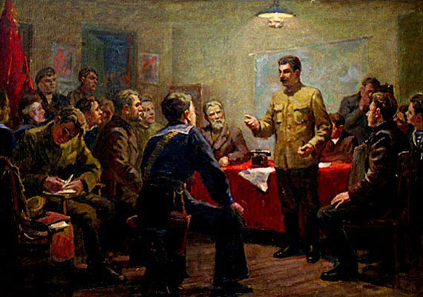

Slide 9
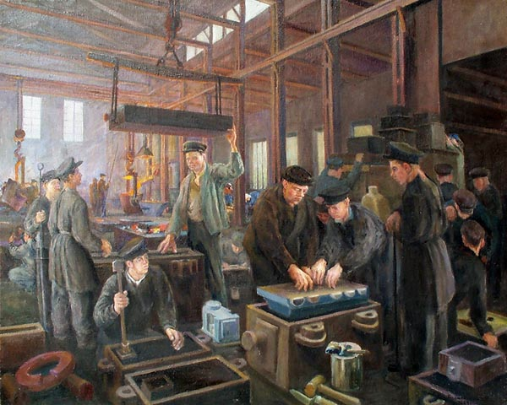

Slide 10
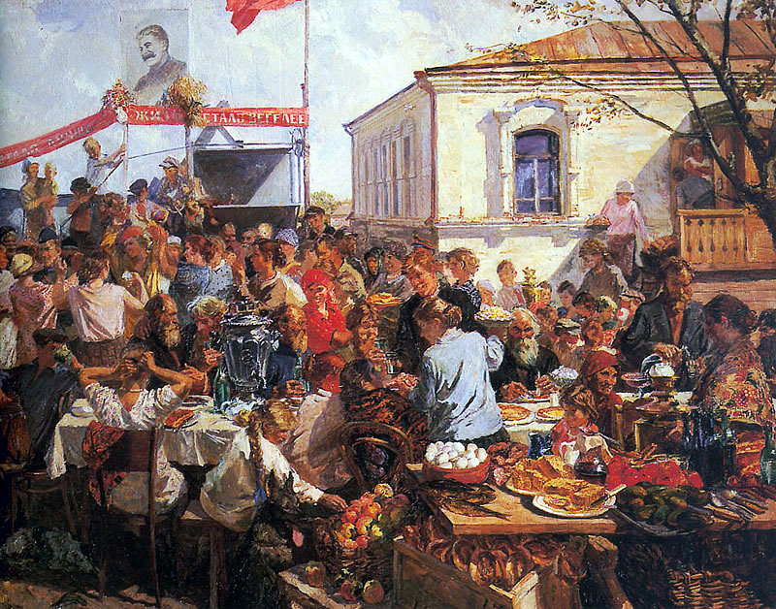

Slide 11
Modern Totalitarian States

Slide 12
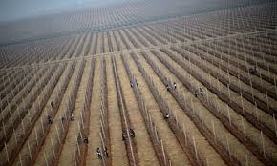
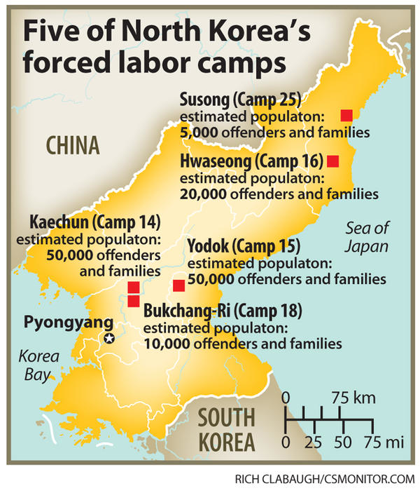
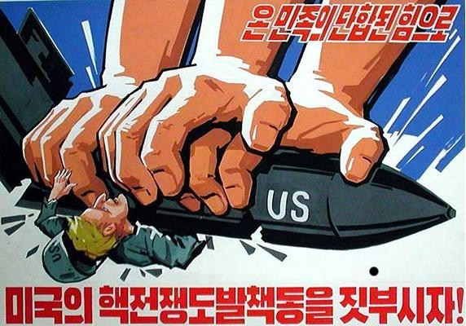
North Korea

Slide 13
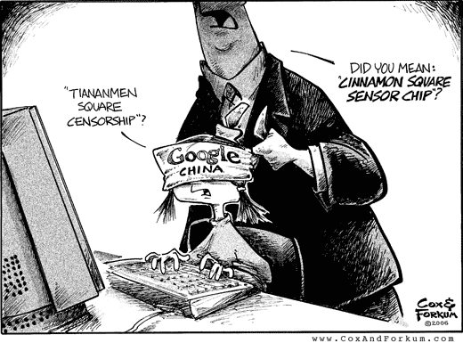
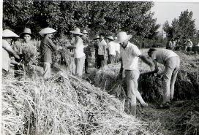
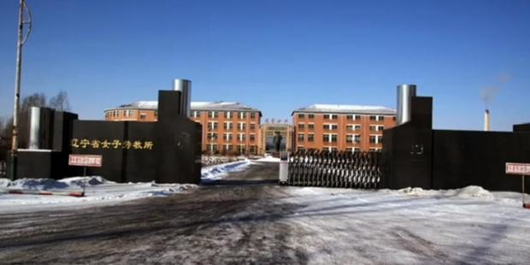
China

Slide 14
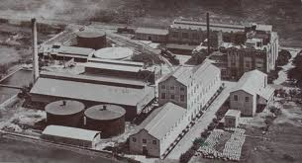
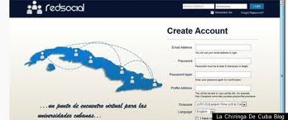
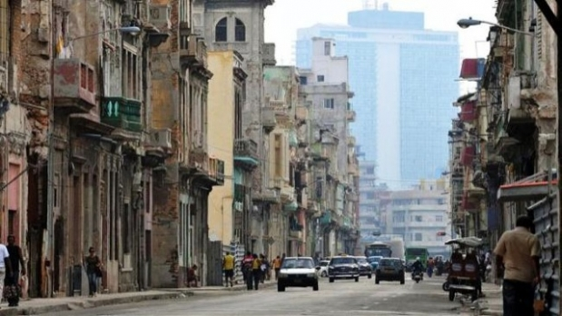
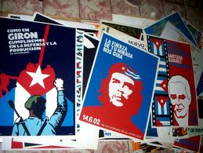
Cuba

Slide 15
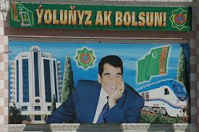
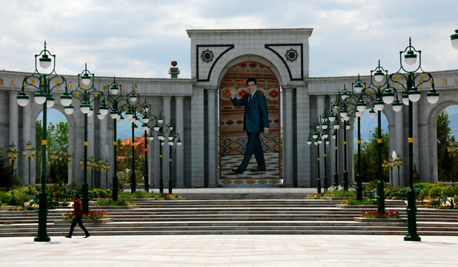
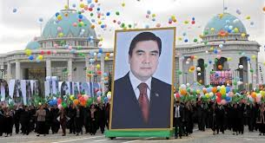
Turkmenistan

Slide 16
Most Censored Countries:
1. Eritrea
2. North Korea
3. Syria
4. Iran
5. Equatorial Guinea
6. Uzbekistan
7. Burma
8. Saudi Arabia
9. Cuba
10. Belarus
11. Turkmenistan
12. China
13. Ethiopia
14. Vietnam
15. Sudan

