Slide 1
Creating a New France

Slide 2
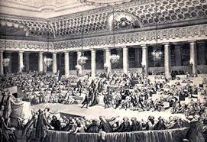
Moderate Reforms
The National Assembly abolished the privileges of the Nobility
Issued the “Declaration of the Rights of Man and the Citizen”
Men born free and equal in rights, all given natural rights
“Liberty, equality, fraternity!”

Slide 3
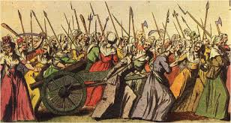
Women’s March on Versailles
In October, women marched from Paris to Versailles
Especially hated Louis XVI’s wife Marie Antoinette (“let them eat cake!”)
Demanded the king return to Paris with them and remained a prisoner in his own palace in Paris

Slide 4
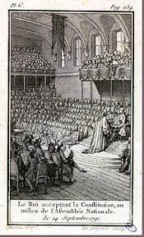
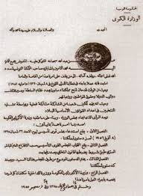
Constitution of 1791
Took over the land owned by the Church
Put the Church under state control
Angered many Catholics
Created a Constitution
Limited monarchy created
Legislature to create laws, collect taxes
Elected by tax-paying male citizens

Slide 5
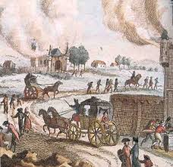
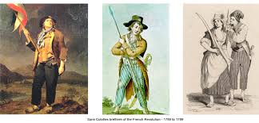
Widespread Fear
Revolution frightened many nobles and monarchs in Europe because they feared it would spread
Other monarchs (who were related to Louis XVI!) threatened war on France
Conflict emerged within France between moderates and radicals

Slide 6
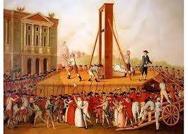
Radical Days
French Revolution

Slide 7
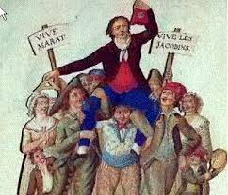
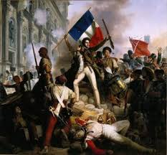
Monarchy Abolished
Radicals took over the National Assembly
Made up of Jacobins
Made many changes
Voted to abolish the monarchy
Created a new constitution
Seized the lands of the nobility and abolished their titles

Slide 8
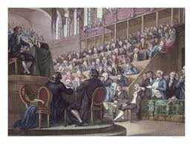
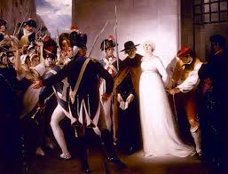
Trial and Execution
The Convention put Louis XVI on trial as a traitor to France
King convicted and sentenced to death
In January 1793, Louis was beheaded
In October, Marie Antoinette was also executed

Slide 9
Committee of Public Safety
By 1793, France was at war with most of Europe
Britain, Netherlands, Spain and Prussia
The National Convention created the Committee of Public Safety
They had absolute power in France
Issued a levee en masse that required all citizens to contribute to the war effort
Invaded the Netherlands and Italy

Slide 10
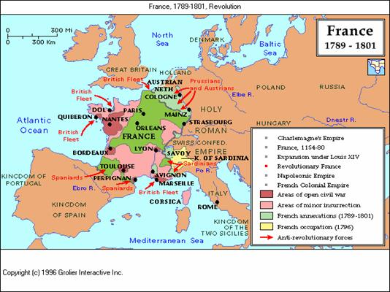

Slide 11
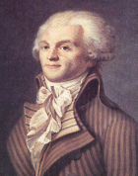
Robespierre
Maximilien Robespierre was the leader of the Committee of Public Safety
Wanted to abolish slavery and grant religious toleration
Wanted to create a “Republic of Virtue”
Robespierre was the architect of the Reign of Terror which lasted from July 1793-July 1794
Around 40,000 people convicted of being counter-revolutionaries died during the Terror
Eventually, the Committee turned on Robespierre and he was also executed during the Reign of Terror in July 1794

Slide 12
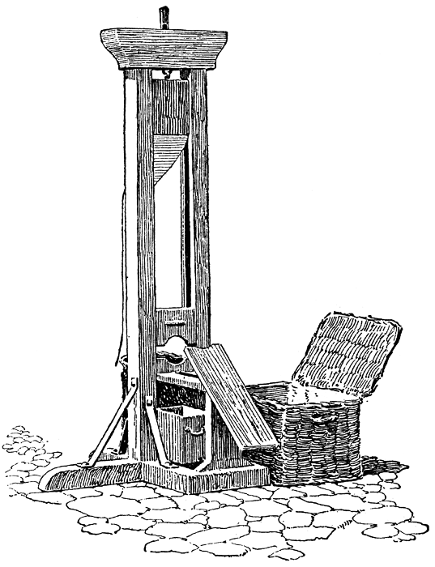
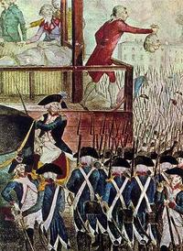
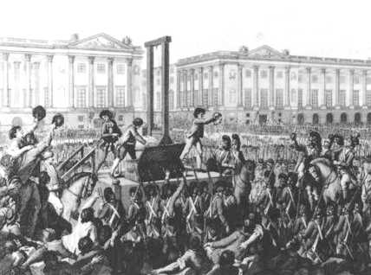
Guillotine
The instrument of death used during the Reign of Terror was the guillotine
It was a fast-falling blade that would immediately behead the person sentenced to death
Was thought to be “more humane” than the axe
Became a symbol of terror during the French Revolution

Slide 13
Constitution of 1795
Moderates came to power after the Reign of Terror and created a new Constitution (the third one since 1789)
Created a five-man Directory with a two-house legislature elected by male citizens who owned property
In effect from 1795-1799
Made peace during this time with Prussia and Spain though fighting continued with Austria and England

Slide 14
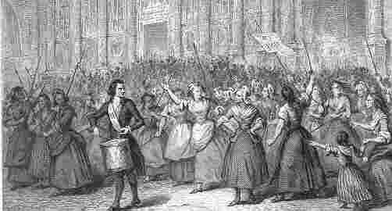
Role of Women
Women participated during the French Revolution as well by creating political clubs
Olympe de Gouges created the Declaration of the Rights of Woman and was later executed by the guillotine
Women gained some rights like the right to inherit property and divorce became easier
In 1793, these women’s clubs were banned for being counter-revolutionary

Slide 15
Social Reform
Revolutionaries pushed for social reforms and religious toleration
Set up schools and organized systems to help those in need
Abolished slavery in France’s Caribbean colonies
Created a secular (non-religious) calendar with 1793 as Year I

Slide 16
Nationalism
Created a French national identity
Nationalism: a strong feeling of pride and devotion to one’s country
New symbols of freedom emerged during the French Revolution
People called each other “citizens”, no more titles for nobility
French tricolor flag
Banned large wigs and extravagant clothing

