Slide 1
Enlightenment Ideas Spread

Slide 2
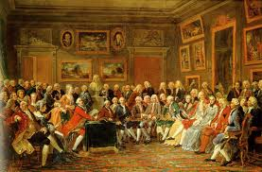
Challenge of New Ideas
Censorship
Government and church leaders tried to hold on to the old ways
They used censorship, restricting access to ideas and information
They banned books and imprisoned writers
Salons
New literature, arts, science,
and philosophy were discussion
topics in salons.
Salons are informal social gatherings where people exchanged ideas.

Slide 3
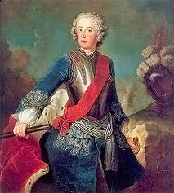
Enlightened Despots
Enlightened despots are absolute rulers who used their powers to bring about political and social changes
Frederick the Great
King of Prussia (Germany)
from 1740-1786
Admired the work of Voltaire
Revived agriculture
Granted religious toleration

Slide 4
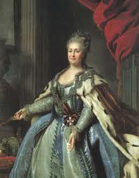
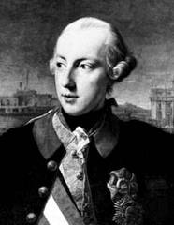
Enlightened Despots
Catherine the Great
Queen of Russia
Made limited reforms in land and
government like state-sponsored
education for boys and girls
Joseph II
This Hapsburg emperor was the most
enlightened despot
Called the “peasant emperor”
Granted toleration to Protestants and Jews
Ended censorship
Abolished serfdom

Slide 5
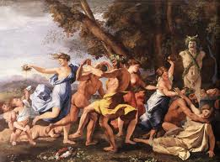
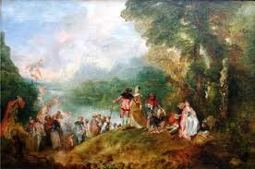
Arts and Literature
Courtly art
Baroque paintings were large
and colorful
Rococo art was personal, charming and elegant
Middle class audience
Successful merchants and town
officials liked art of family life
or realistic town and country scenes

Slide 6
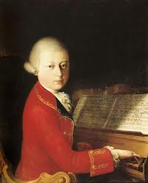
Arts and Literature
Trends in music
Ballet and operas were performed at
royal courts
New musicians were introduced
Johann Sebastian Bach, George Frederick Handel, and Wolfgang Amadeus Mozart are all from this time period
Novels
Middle class audiences liked stories written as novels

Slide 7
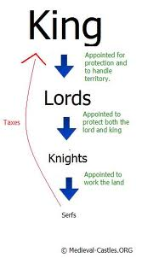
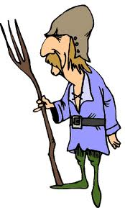
Lives of the Majority
Most were unaffected by courtly behavior
In central and eastern Europe,
serfdom continued
Peasants (serfs) were bought
and sold with the land

