Slide 1
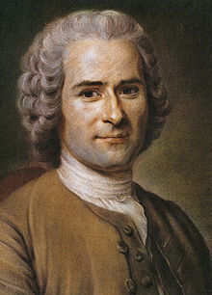
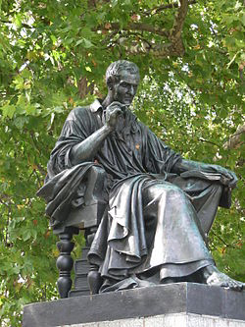
Jean-Jacques Rousseau
Political Philosophy

Slide 2
Who was this mysterious man?!
Jean-Jacques Rousseau lived from 1712-1778 who was from Geneva
He was a philosopher, writer, and composer of Romanticism and French expressionism
His political philosophy greatly influenced the French Revolution as well as the development of modern political, sociological, and educational thought

Slide 3
Rousseau’s State of Nature
Rousseau believed that in the state of nature, people were naturally good, independent, compassionate and peaceful
He believed that before societies existed, people were not corrupted
What has corrupted the natural goodness of people is modern society
It makes people less virtuous and unhappy

Slide 4
Rousseau’s Ideal Government
Because of his views of the state of nature, Rousseau believed that direct democracy was best for countries
It would be ideal in making laws for government because everyone would have a say in how the government is run
Rousseau’s ideal government would consist of two parts
1. All adult males would make up the part of the government that creates the laws
2. Representatives could then be elect to carry out or enforce the law
He argued that people would enter into a “social contract” with the government
In this social contract, people give up some of their rights (like the right to murder) for a more just and orderly society

Slide 5
Why was Rousseau so controversial?
Rousseau published Of the Social Contract, Principles of Public Right in 1762
Rousseau’s ideas were so radical that he was forced to flee France in 1770 and his book was banned
At the time, even most philosophers thought that freedom was the same as chaos or anarchy
Rousseau’s ideas differed from the political philosophers at the time
Rousseau believed that if people rule themselves, they can be both governed and free
The social contract enabled them to have a direct say in their laws but still to be governed by them

